Slide 1
Woodrow Wilson
By: Darcy and Rory

Slide 2
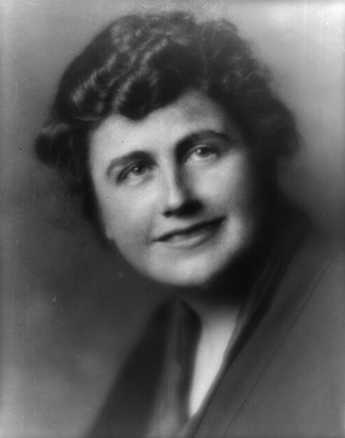
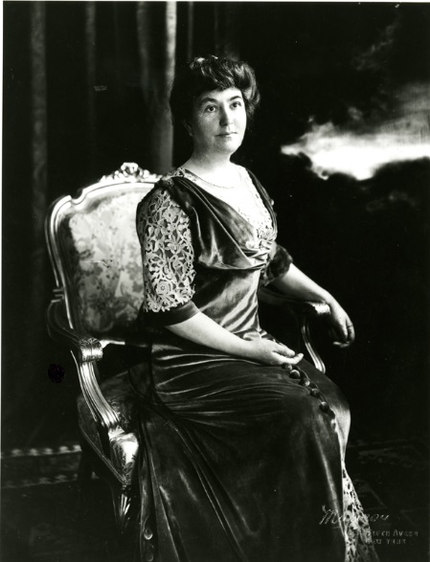
PRESIDENT`S PERSONAL FACTS
Woodrow Wilson was born December 28, 1856 in Virginia.
His mom and dad were Jessie and Joseph.
He was the 3rd child.
He lived in Staunton, Virginia.
He went to the College of New Jersey.
He married Ellen Louise Axson. After she died, he married Edith Galt.

Slide 3
Personal fact
They had 3 children.
They had a ram, a sheep, chickens and cats.
He was a teacher and a public official.
Wilson die February 3rd, 1924 in Washington D.C. from complications of a stroke.

Slide 4
President In Office Facts
Woodrow Wilson was 28th President.
He was the President from 1913 to 1921.
Wilson was 57 when he became President.
His Vice President was Thomas R. Marshall.

Slide 5
President In Office Facts
His political party was Democrat.
He got 6,296,547 votes.
He made $75,000 a year.
There was war when Wilson was president . The War was World War I.

Slide 6
Fun Facts
His nickname was schoolmaster in politics.
His religion was Presbyterian.
Woodrow Wilson was one of the top five presidents.
He was the first President to meet the Pope while he was in office.

Slide 7
Fun facts
Wilson won the Nobel Peace Prize .
Woodrow Wilson began college when he was just sixteen old.
He warned congress that he meant to lead the country.

Slide 8
By Darcy
By Rory

Slide 9
Resources
POTUS
President Encyclopedia
Fact Monster
Miller Center
Presidential Pets by Julia Moberg
I Wish I Knew That President by P.A Halbert

Slide 10
The End

