Slide 1
George Herbert Walker Bush
By Mary Caroline and Mayes

Slide 2
President `s Personal Facts
George Herbert Walker Bush was born on June 12, 1924 in Milton, Massachusetts.
His mother and father’s names were Dorothy Walker Bush and Prescott Sheldon Bush.
He had 4 brothers and sisters.
He lived in Odessa Texas.

Slide 3
President`s Personal Facts
He went to school at Yale University.
He married Barbara Pierce on January 6, 1945.
He has 6 children named George, Robin, John Ellis, Neil, Marvin and Dorothy and he had two springer spaniels Millie and Ranger.

Slide 4
President’s Personal Facts
He was a businessman and a public official.
He is still alive!

Slide 5
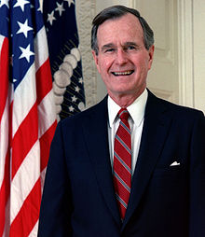
In Office Facts
George Herbert Walker Bush was the 41st President.
He was President from 1989 to 1993.
He was 65 when he became President.
His Vice President was Danforth Quayle.

Slide 6
In Office Facts
His votes in 1988 were 48,881,278.
He made $200,000 a year and a $50,000 expense account.
There was a war called the Persian Gulf War when he was president.

Slide 7
Fun Facts
His nickname was Poppy.
His dog Millie birthed six new puppies and joined the family. She had five daughters and one son.
He went skydiving out of an airplane flying 7,500 feet on his seventy-fifth birthday.

Slide 8
By Mayes
By Mary Caroline

Slide 9
Resources
POTUS
President Encyclopedia
Fact Monster
Miller Center
Presidential Pets by Julia Moberg
I Wish I Knew That President by P.A Halbert

Slide 10
The End

