Slide 1

Abraham Lincoln
By: Owen and Mary Kate

Slide 2
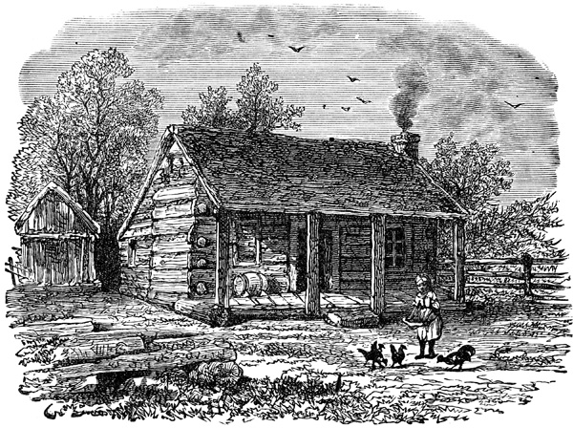
PRESIDENT PERSONAL FACTS
Abraham Lincoln was born on February 12th, 1809 Hardin County Kentucky.
His parents were Thomas Lincoln and Nancy Hanks.
His brother’s name was Thomas and his sister’s name was Sarah.
Lincoln had no formal education.
He had 4 kids. They were Robert, Edward, William and Tad.

Slide 3
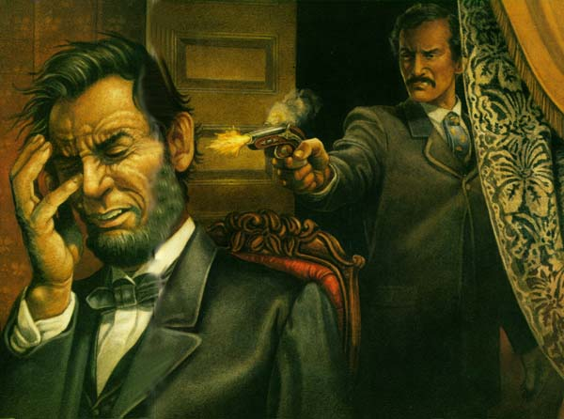
PERSONAL FACTS
Lincoln’s wife’s name was Mary.
He was a lawyer before he was president.
Abe had a turkey, goats, ponies, cats, dogs, pigs and a white rabbit.
He got shot in the back of the head and he died at a theater in Washington, DC. He died on May 8th, 1860.

Slide 4
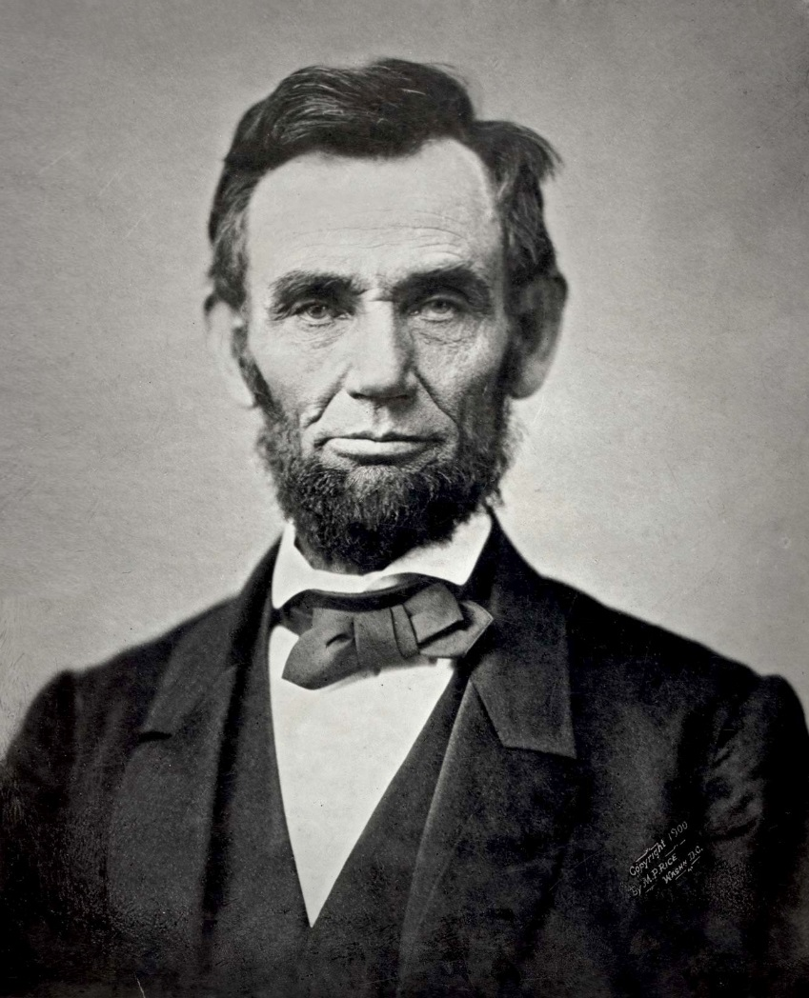
PRESIDENT IN OFFICE FACTS
He was the 16th President.
He was President March 4th 1861 to April 15th, 1865.
He was 52 when he was elected.
His Vice Presidents were Hannibal Hamlin and Andrew Johnson.
His Political Party was Republican.

Slide 5
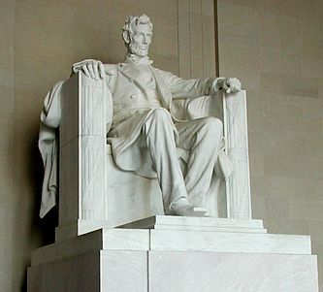
PRESIDENT IN OFFICE FACTS
He made a salary of $25,000 a year.
There was a Civil War when he was President.
1,865,908 people voted for him.

Slide 6
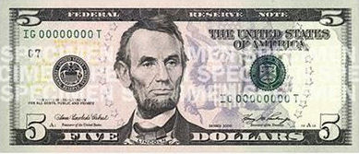
PRESIDENT FUN FACTS
He was the tallest president.
He had a turkey, goats and a pony.
He kept the United States as one nation with liberty for all .

Slide 7
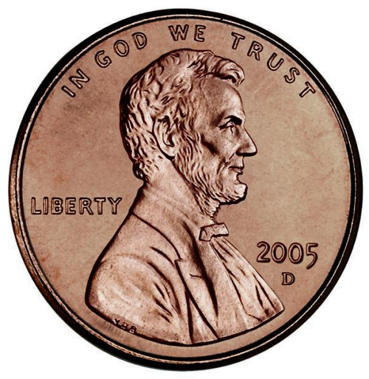
Fun Facts
His nicknames were “Honest Abe” and “Illinois Rail Splitter”.
Abraham was the tallest president. He was 6 feet 4 inches tall.

Slide 8
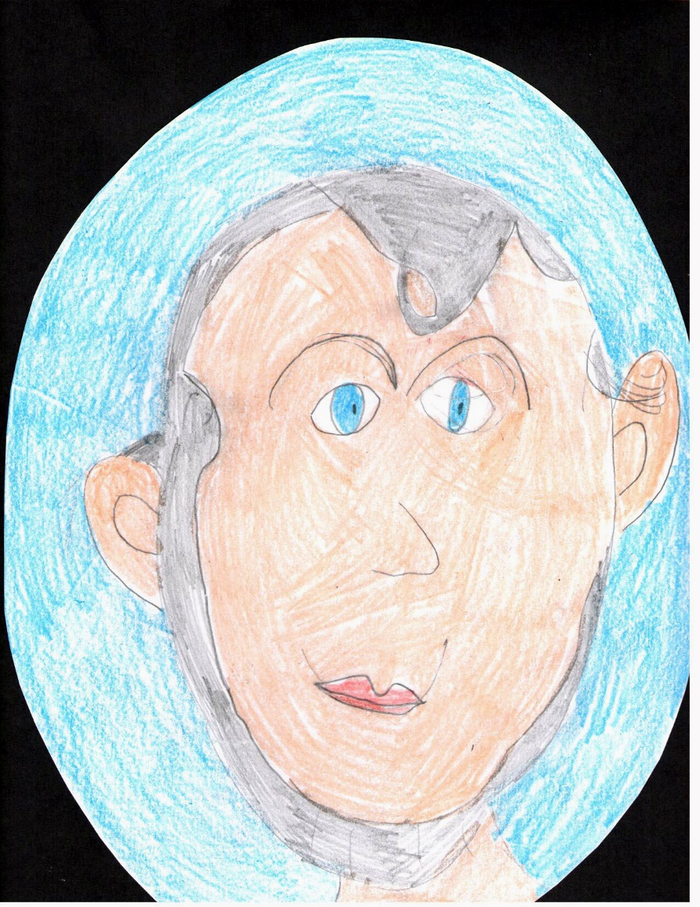
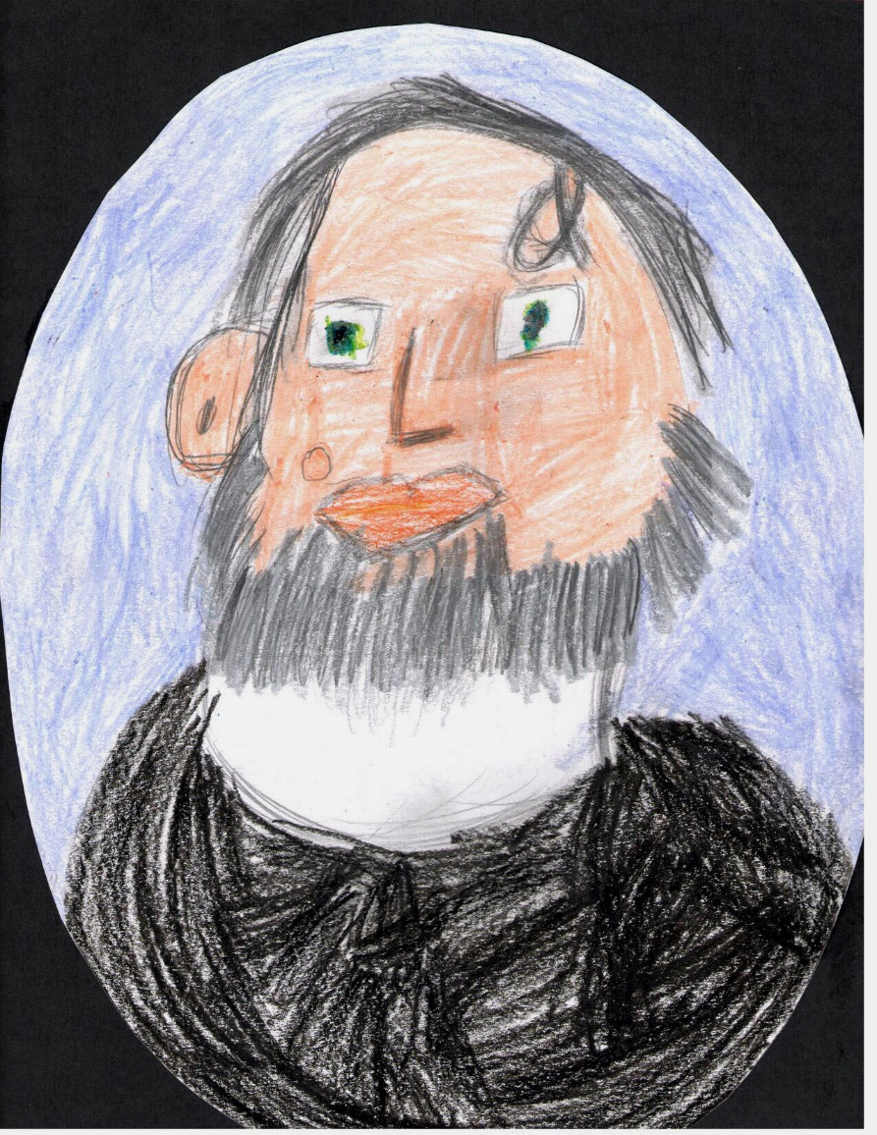
By Mary Kate
By Owen

Slide 9
Resources
POTUS
President Encyclopedia
Fact Monster
Miller Center
Presidential Pets by Julia Moberg
I Wish I Knew That President by P.A Halbert

Slide 10
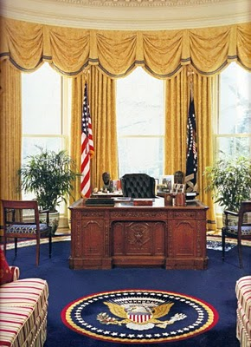
THE END

