Slide 1
Abraham Lincoln
By Emma and Margaret

Slide 2
PERSONAL FACTS
Abraham Lincoln was born February 12th, 1809 in Hardin County, Kentucky.
His parents were Thomas and Nancy Hanks.
He had no brothers or sisters.
He lived in Illinois.
He did not go to school.

Slide 3
PERSONAL FACTS
His first lady was Mary Todd.
Lincoln had 4 children named Robert, Edward, William and Thomas.
He had 7 pets. He had a goat, a turtle, a pony, a cat, a dog, a pig, and a rabbit.
Abraham Lincoln was a lawyer before he was president.

Slide 4
President in Office Facts
The first time he ran he got 1,865,593 votes and the 2nd time he got 2,206,938 votes.
He got $25,000 a year.
America fought the Civil War when he was President.

Slide 5
President In Office Facts
He was the 16th President.
He was in office from 1861 to 1865.
He was 52 when elected.
Hannibal Hamlin and Andrew Johnson were his Vice Presidents.
He was a Republican.

Slide 6
FUN FACTS
Lincoln was surprisingly disliked during his lifetime.
He was the tallest president.

Slide 7
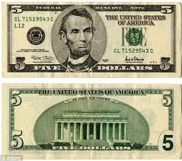
Fun Facts
He declared the slaves free.
He had a wart on his right cheek, a scar on his thumb from an ax accident, and a scar over his right eye from a fight with a gang of thieves.

Slide 8
By: Emma
By: Margaret

Slide 9
Resources
POTUS
President Encyclopedia
Fact Monster
Miller Center
Presidential Pets by Julia Moberg
I Wish I Knew That President by P.A Halbert

Slide 10
THE END

