Slide 1
James Earl Carter JR.
By Jake and Mahala

Slide 2
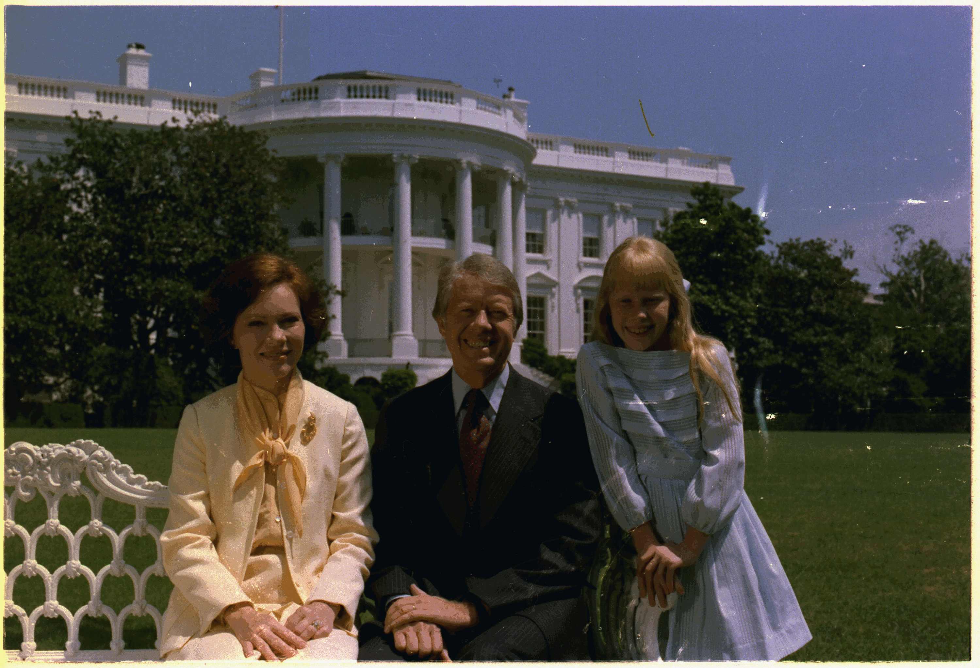
Personal Fact
Jimmy Carter was born on October 1st, 1924 in Plains Georgia.
The names of his mother and father were Lillian Gordy Carter and James Earl Carter.
Jimmy Carter had one sister and two brothers.
Jimmy Carter lived in Georgia.

Slide 3
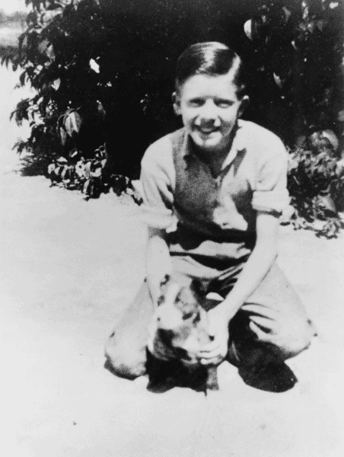
Personal Facts
Jimmy Carter went to Annapolis school.
His wife was Eleanor Rosalynn Smith.
Jimmy Carters kids names were Jack, Chip, Jeff, and Amy.
Carter had one dog and one cat.

Slide 4
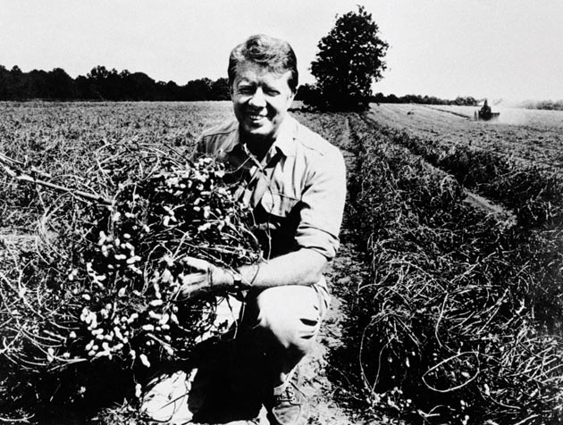
Personal Facts
Jimmy Carter was a peanut farmer before he was President.
Jimmy Carter and Rosalynn Carter are alive and make homes for Habitat for Humanity.

Slide 5
In Office Facts
Jimmy Carter was the 39th President.
He was in the office from January 20th, 1977 to January 20th 1981.
His Vice President was Walter Mondale.
He was in the Democrat political party.

Slide 6
In Office Facts
Carter got 40,877,977 votes.
He made $200,000, a year and $50,000, expenses.
There was no war when he was president.

Slide 7
Fun Facts
Carter was in the Navy.
He was the best player on his basketball team.
Jimmy Carter was the Governor of Georgia.

Slide 8
Fun Facts
Jimmy Carter has been one of the most active former Presidents in history.

Slide 9
By Mahala Bell.
By Jake Bodiford.

Slide 10
THE END

