Slide 1
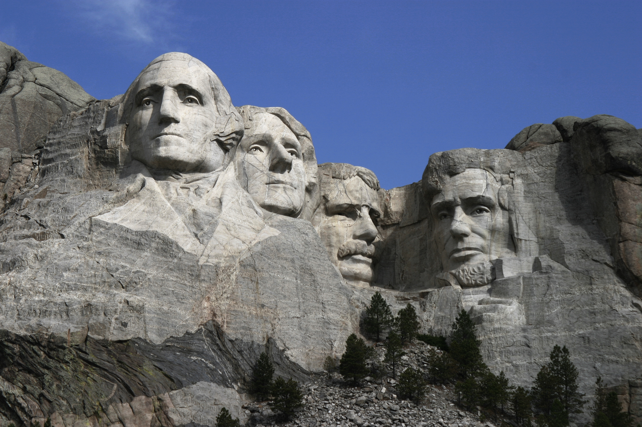
Thomas Jefferson
By Maggie and Logan

Slide 2
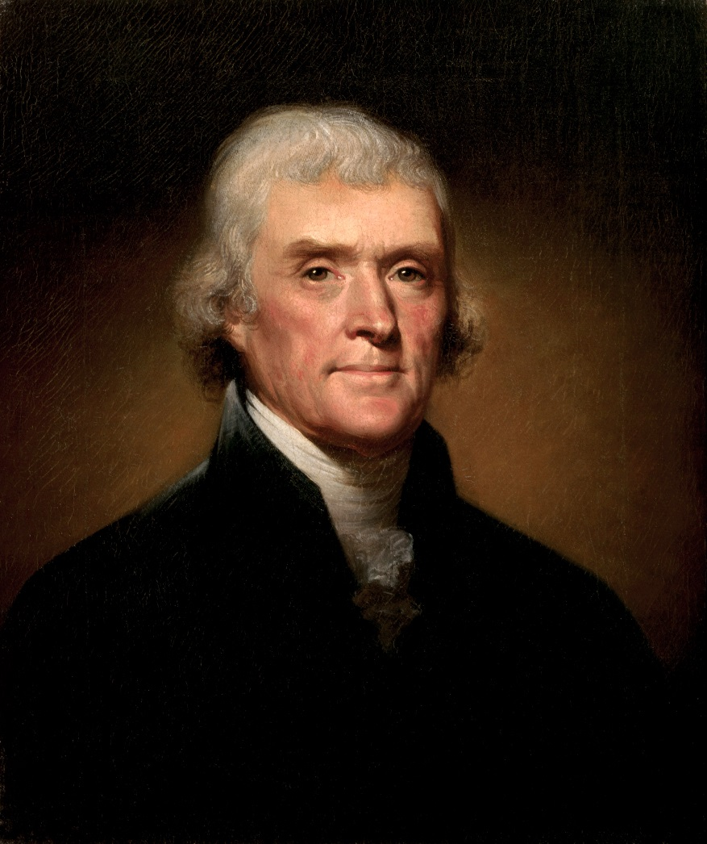
Personal Facts
Thomas Jefferson was born April 13th, 1743 in Shadwell, Virginia.
He had no brothers or sisters.
His mom and dad were Peter and Jane.
His first lady was Martha Wayles Skelton.
He had three pets, a Mockingbird and two bear cubs.

Slide 3
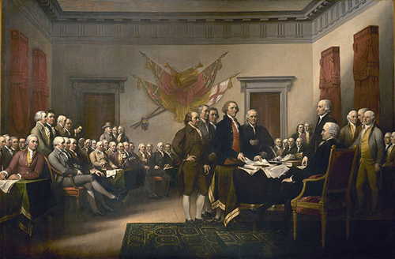
Personal Facts
Before Thomas Jefferson was president he had two jobs, a lawyer and a planter.
He graduated from the College of William and Mary.
He had no kids.
He was President from March 4th, 1801 to March 3rd, 1809
Thomas Jefferson died July 4th, 1826 at Monticello.

Slide 4
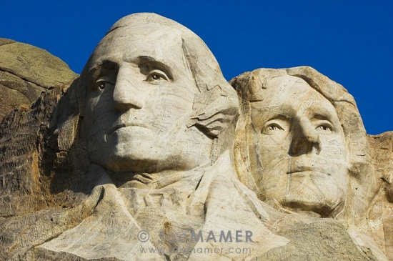
President In Office Facts
Thomas Jefferson was the 3rd President.
He was in Office from March 4th, 1801 to March 3rd,1809.
He was 58 when he became President.
Thomas Jefferson’s Vice Presidents were Aaron Burr and George Clinton.

Slide 5
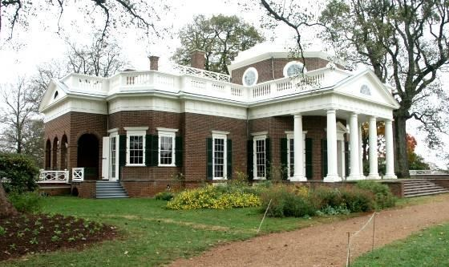
President In Office Facts
Thomas Jefferson was a Democratic-Republican.
He had a salary of $25,000 a year.
There was not a war when he was President.

Slide 6
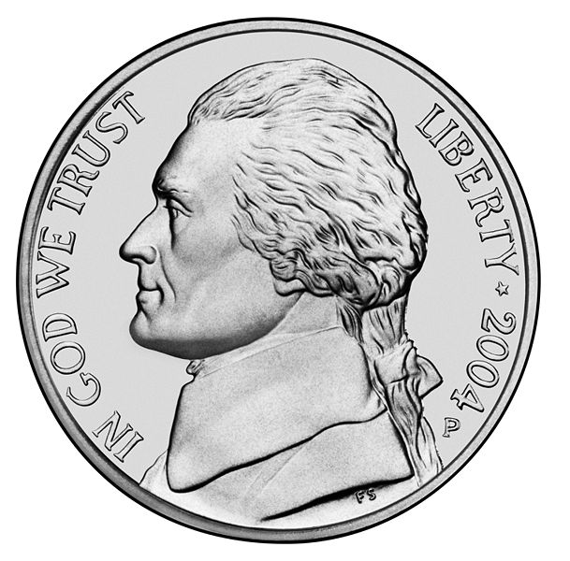
Fun Facts
Thomas Jefferson’s nicknames were “Man of the People” and “Sage of Monticello”.
He was Vice President for John Adams.
He was a Minister to France.
He was also Governor of Virginia.

Slide 7
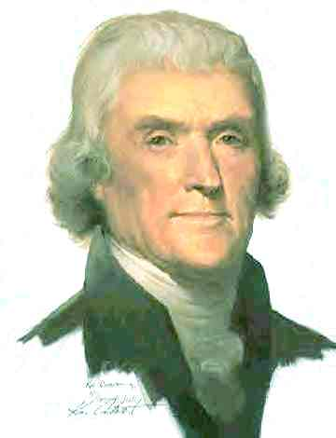
Fun Facts
Thomas Jefferson became the very first President to shake hands with visitors to the White House.

Slide 8
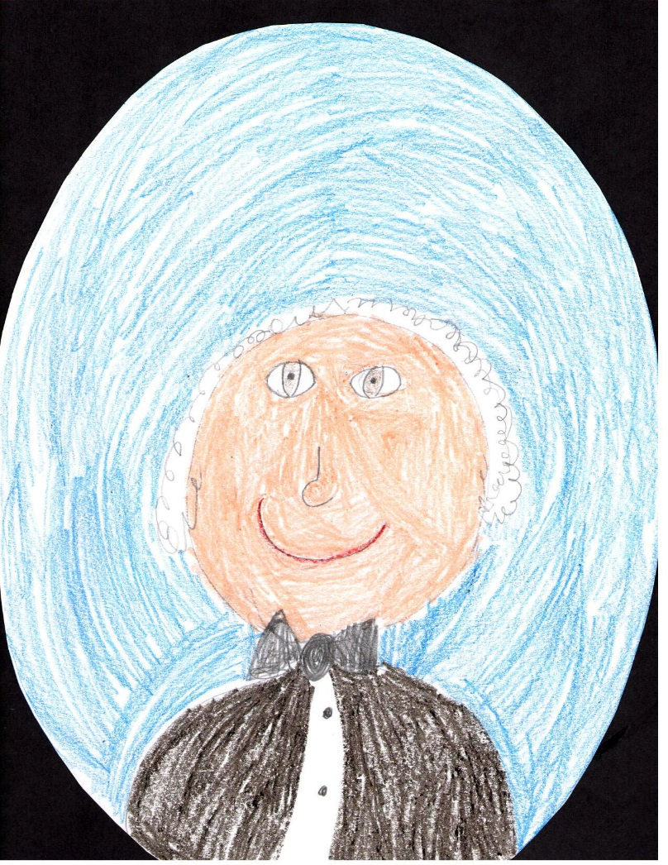
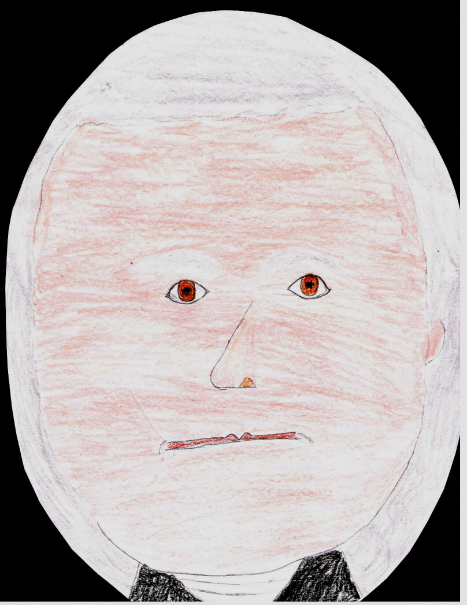
By: Logan By: Maggie

Slide 9
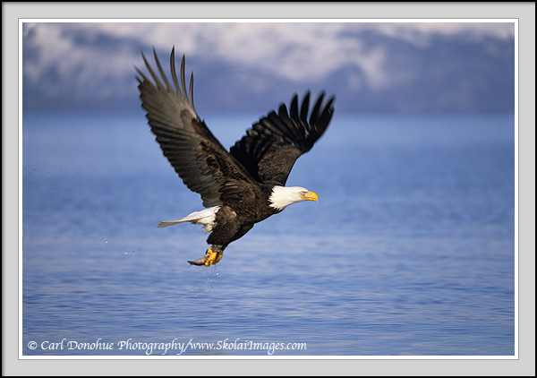
THE END

