Slide 1
Ronald Wilson Reagan
By Mac Cobb
and
Anne Marie Combs

Slide 2
Personal Facts
Ronald Reagan was born February 6th, 1911 in Tampico, Illinois.
His dad was named John Edward Reagan and his mom was Nelle Wilson Reagan.
He had 1 brother named Neil.
Before he lived in California he lived in Illinois.
Reagan graduated from Eureka College.

Slide 3
Personal Facts
His 1st wife was Jane Wyman. She was not the first lady. Nancy Davis was the 1st Lady.
He had 4 kids and their names are Maureen, Michael, Patricia, and Ronald.
Reagan had 2 pets named Lucky and Rex .

Slide 4
Personal Facts
Before he was President he was a movie actor and Governor of California.
Ronald Reagan died on June 5th, 2004 in Los Angeles, California.

Slide 5
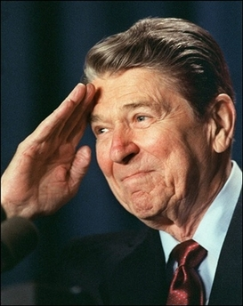
In office facts
Ronald Reagan was the 40th president.
He was in office January 20th, 1981 to January 20th, 1989.
Reagan was 69 when he was elected president.
His Vice President was George H.W Bush.
His Political Party was Republican.

Slide 6
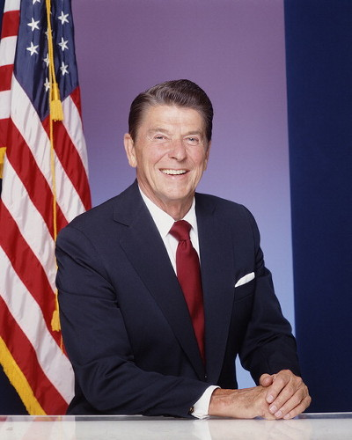
In office facts
In 1976 Reagan lost by a lot. In 1980 43,267,489 people voted for him. In 1984 53,428,357 people voted for him.
He made $250,000 a year.
There was no war while he was president.

Slide 7
Fun Facts
When Reagan was a kid he was a lifeguard.
He played on a football team.
He was divorced and he got married 2 times.
Reagan’s family was very poor.

Slide 8
Fun facts
He acted in more than 50 movies.
Reagan was Governor of California for 8 years.
He won his first run for Governor by almost 1,000,000 votes.

Slide 9
By: Mac Cobb
By: Anne Marie Combs

Slide 10
Resources
POTUS
President Encyclopedia
Fact Monster
Miller Center
Presidential Pets by Julia Moberg
I Wish I Knew That President by P.A Halbert

Slide 11
The End

