Slide 1
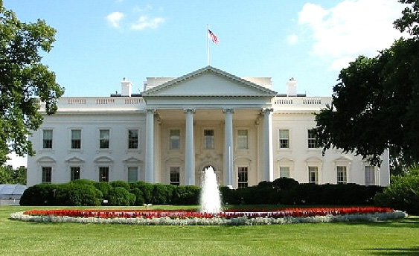
Ronald Wilson Reagan
By: Reagan and Luci

Slide 2
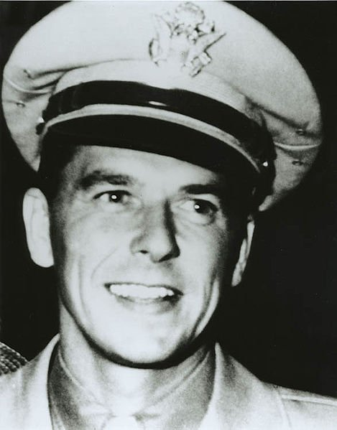
Personal Facts
Ronald Reagan was born on February 6th, 1911 in Tampico Illinois.
His mother was Nelle Wilson Reagan. His father was John Edward Reagan.
Ronald Reagan lived in California.
His brother’s name was Neil.

Slide 3
Personal Facts
He graduated from Eureka College in 1932.
Jane Wyman was his first wife. Nancy Davis was his wife and First Lady.
Ronald Reagan’s kids were Maureen, Michael, Patricia and Ronald.

Slide 4
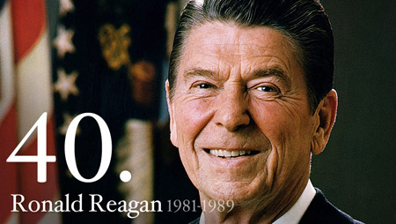
In Office Facts
Ronald Reagan was the 40th President.
He was President from January 20th 1981-Janurary 20th 1989.
Ronald Reagan was 70 when he was elected.
His Vice President was George Bush.

Slide 5
In Office Facts
Ronald Reagan was a Republican.
In 1980 Ronald Reagan got 43,267,489 votes and in 1984 got 53,428,357 votes.
He got $200,000 a year and a $50,000 expense account.
Reagan sent troops to Grenada to oust communists.

Slide 6
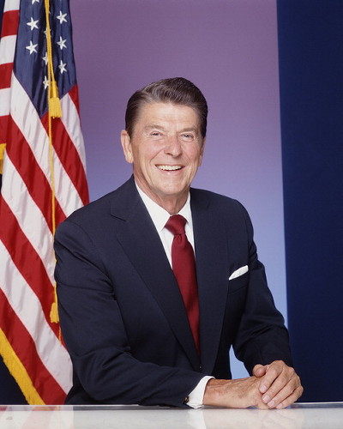
Fun Facts
Ronald Reagan was the 5th left handed President.
On March 30th he was shot in an assassination attempt by John W. Hinkley, Jr. outside of the Washington D.C. Hilton Hotel.
Reagan was Governor of California from 1967-1975.

Slide 7
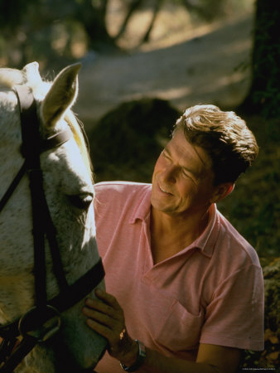
Fun Facts
Ronald Reagan was the only president to be a movie star.
He was the only president to be divorced.

Slide 8
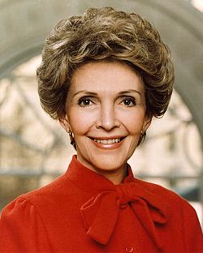
Fun Facts
Ronald Reagan fought in World War II.
He got divorced from Jane Wyman and got married again to Nancy Davis.
Ronald Reagan’s nick names were “The Gipper”, “The Communicator” and “Dutch”.

Slide 9
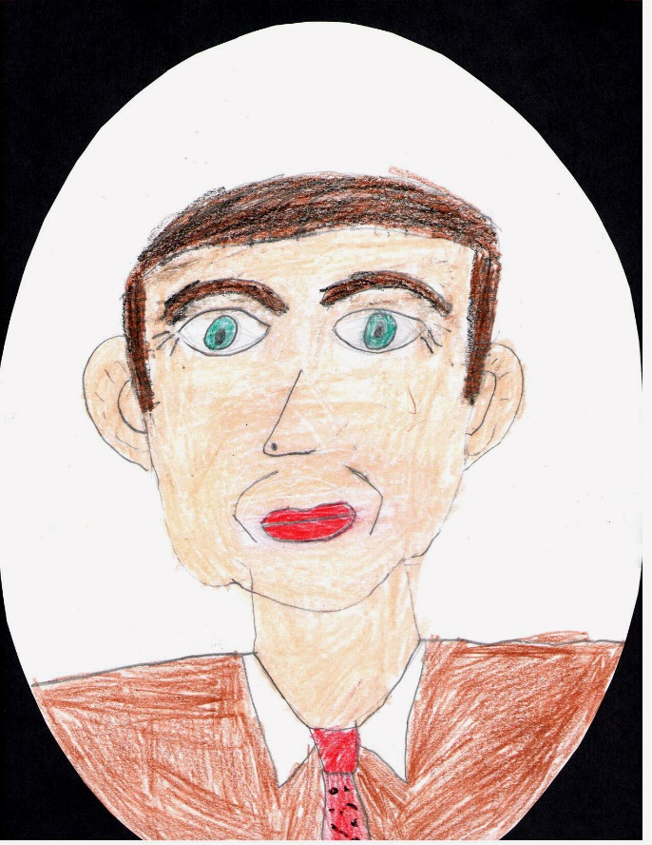
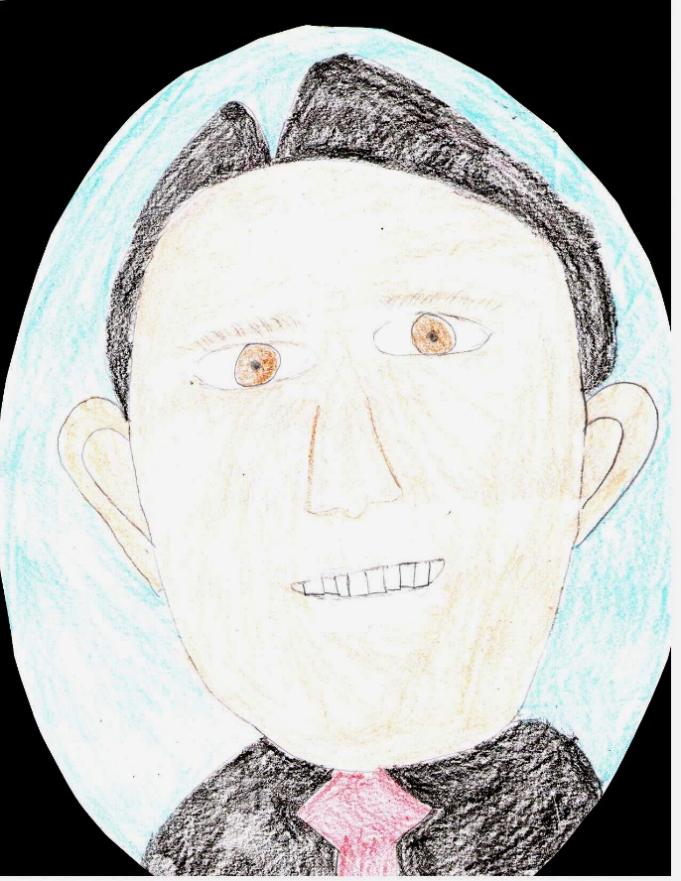
By: Luci
By: Reagan

Slide 10
The End

