Slide 1
Theodore Roosevelt
By Katya and Katie

Slide 2
Personal Facts
Theodore Roosevelt was born on October 27th,1858 in New York.
His wife was Edith Carow.
Roosevelt had 6 children.
He had snakes, pigs, cats, a hyena, a lion, a zebra and many more pets.

Slide 3
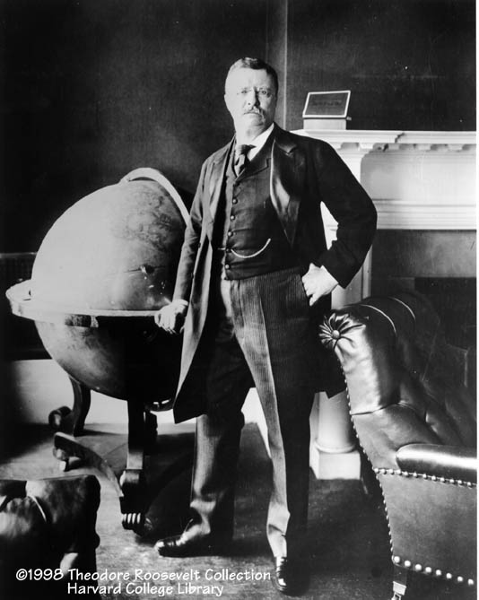
Personal Facts
He was an author, a lawyer and a public official.
He went to Harvard College.
Theodore Roosevelt died on January 6th, 1919 in Oyster Bay, New York.

Slide 4
In Office Facts
Theodore Roosevelt was the 26th President.
He worked in the Oval Office from September 14th 1901 to March 3rd 1909.
The first time when people voted for him he got 7,628,461 votes.

Slide 5
In Office Facts
Theodore Roosevelt made $50,000 a year.
His Vice President was Charles Warren Fairbanks.
His Political party was Republican.
Theodore Roosevelt was 43 when he was elected.

Slide 6
Fun Facts
He was Assistant secretary of the Navy.
He was the Governor of New York.

Slide 7
Fun Facts
Theodore Roosevelt’s nickname was “Trustbuster Teddy”.
Theodore Roosevelt's pet dog bit the pants off a French Ambassador. Roosevelt either had to send the dog away or face a war with France.
He was in the Spanish America War.
He was a member of New York State Assembly.

Slide 8
By Katie
By Katya

Slide 9
Resources
POTUS
President Encyclopedia
Fact Monster
Miller Center
Presidential Pets by Julia Moberg
I Wish I Knew That President by P.A Halbert

Slide 10
THE END

