Slide 1
George H W Bush
By: Harper Watkins
Clara Davis
Ian Dale

Slide 2
PRESIDENT’S PERSONAL FACTS
George Bush was born June 12, 1924 in Milton, Massachusetts .
His mother and father are Prescott Sheldon and Dorothy Walker.
He had 4 brothers and sisters.
He lived in New York in a big house.

Slide 3
President’s Personal Facts
Bush went to Yale University.
His wife was Barbara Pierce.
He had 4 children named Robin, Neil, Marvin and Dorothy.
His pets were Millie, a springer spaniel and Ranger, one of Millie’s pups.
He was Director of the CIA and he was the Vice President.
George Bush is still alive.

Slide 4
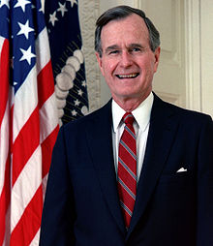
In Office Facts
George H. W. Bush was the 41st President.
George was elected January 20th 1989 and ended January 20th 1993.
He was 65 years old when he was elected.
Dan Quayle was his Vice President.

Slide 5
In Office Facts
George was a Republican.
48,881,278 people voted for him.
He made $ 200,000 + $50,000 a year.

Slide 6
Fun Facts
In 1988 George H W Bush was elected Vice President.
George played first baseman on the Yale University baseball team.
He has not liked broccoli since he was a kid. When he became president he did not have to eat it any more.

Slide 7
By Harper Watkins
By Ian Dale

Slide 8
By Clara Davis

Slide 9
Resources
POTUS
President Encyclopedia
Fact Monster
Miller Center
Presidential Pets by Julia Moberg
I Wish I Knew That President by P.A Halbert

Slide 10
Thank you for watching

