Slide 1
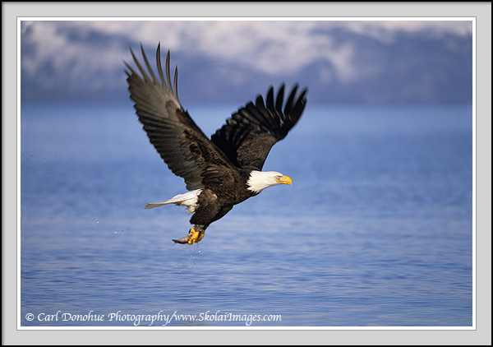
John Adams
By Harper and Indigo

Slide 2
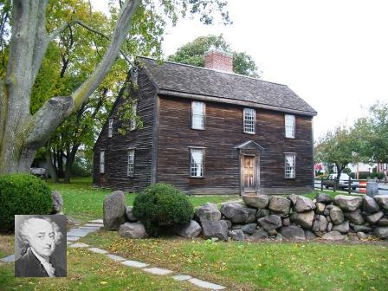
PERSONAL FACTS
John Adams was born in October 30th, 1735 in Massachusetts.
John Adam’s Mum and Dad names were Susanna Boylston and John Adams.
John Adams had 2 brothers named Peter and Elisha.
He went to Harvard College.

Slide 3
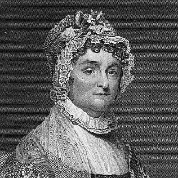
Personal Facts
John Adams wife’s name was Abigail Smith.
He had 2 girls named Abigail and Amelia.
John Adams had a lot of horses.
He was a teacher and a lawyer before he was President.
John Adams died on July 4th, 1826 in Quincy, Massachusetts.

Slide 4
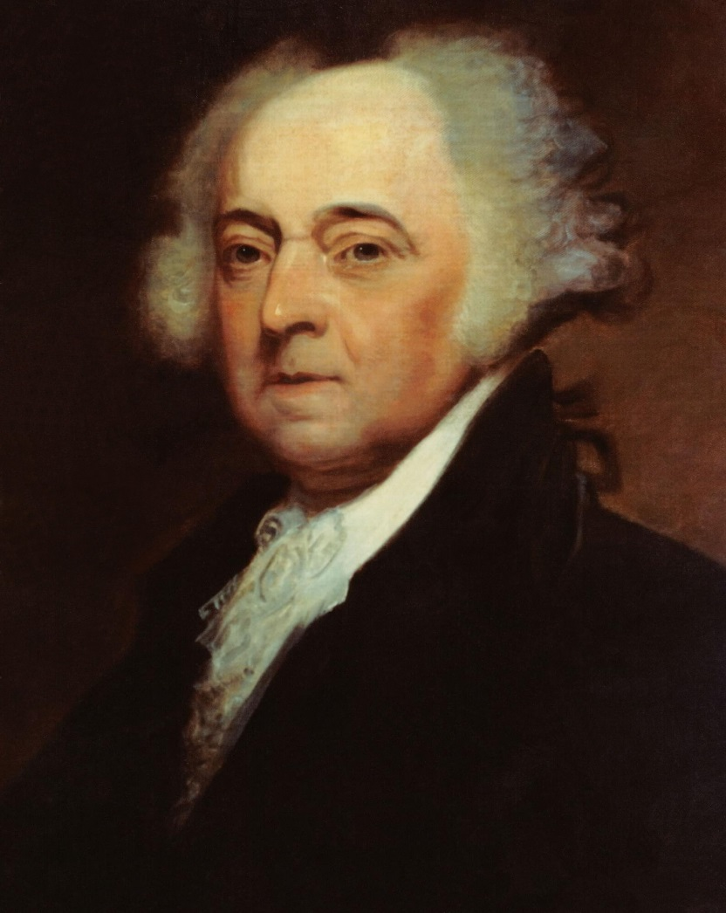
IN OFFICE FACTS
John Adams was the 2nd President.
He was president from March 4, 1797 to March 3, 1801.
He was 62 when he became president.
His Vice President was Thomas Jefferson.

Slide 5
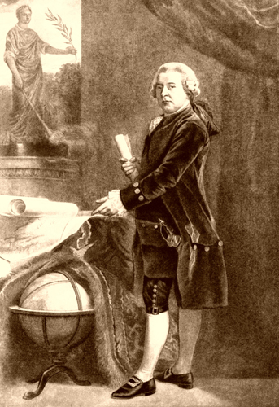
In Office Facts
His Political party was the Federalist.
He made $25,000 per year.
He was in the Quasi war with France.

Slide 6
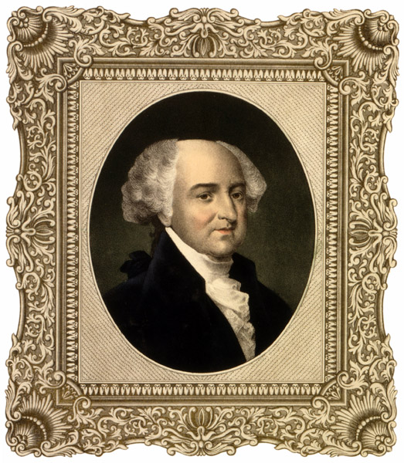
Fun Facts
Adams was George Washington’s Vice President.
He was the first president to live in the White House.
He wrote the Massachusetts State Constitution.
John Adams helped Jefferson draft the Declaration of Independence.

Slide 7
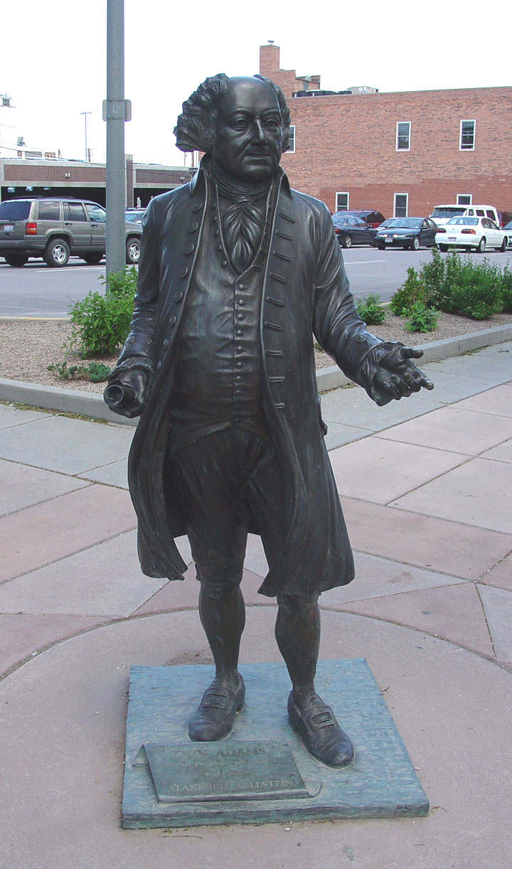
Fun Facts
Adams was the first president from the federalist party.
He was the only president to have a vice president from the opposing party.
His nickname was “The Colossus of Independence”.

Slide 8
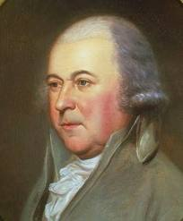
Fun Facts
He put together the very first United States Navy.
He signed the Declaration of Independence.
He died on the same day as Thomas Jefferson.

Slide 9
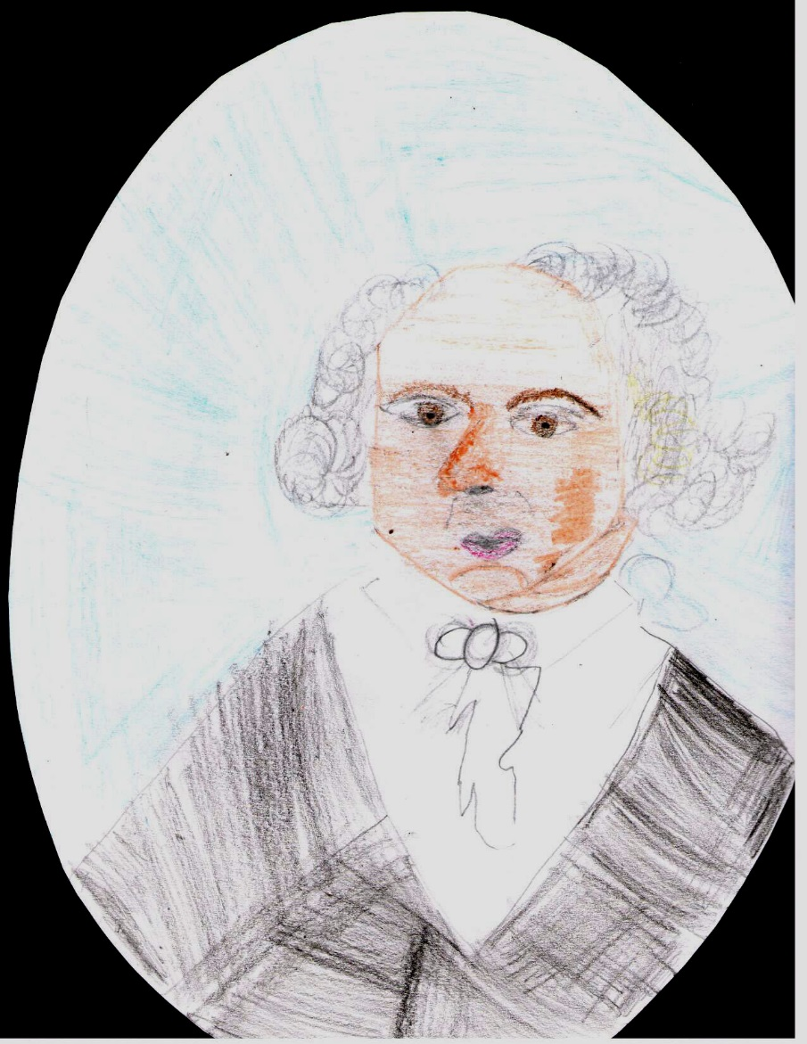
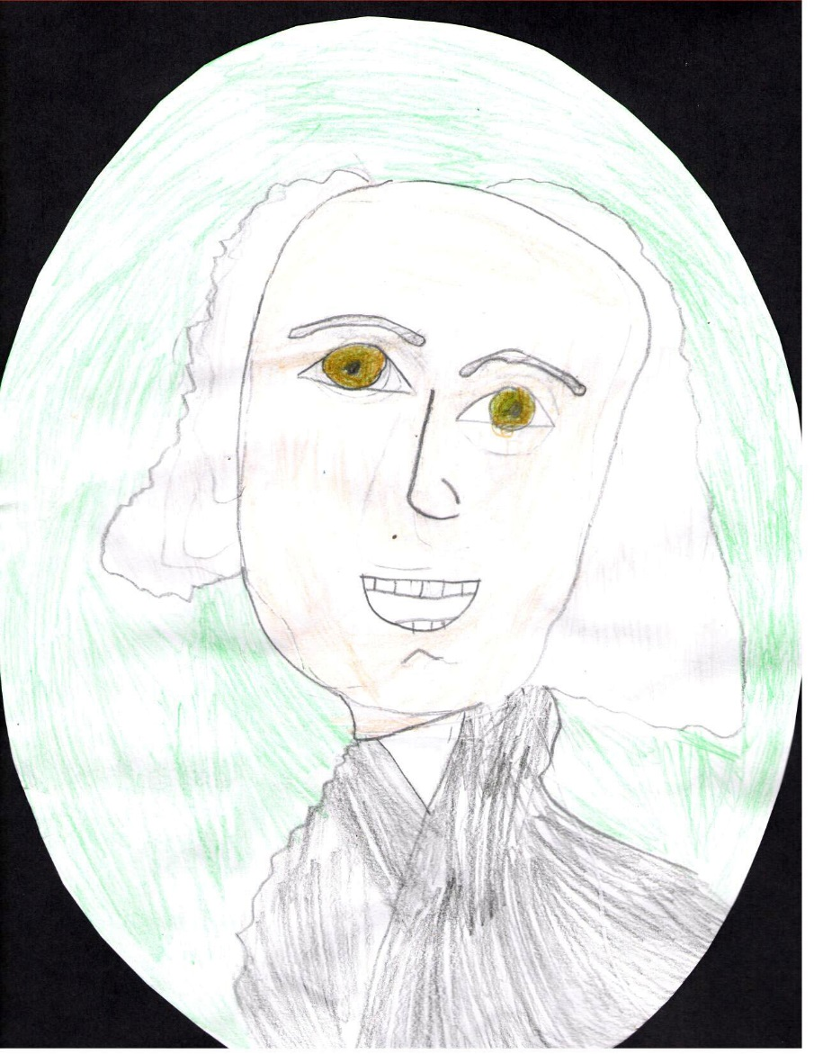
By Indigo
By Harper

Slide 10
Resources
POTUS
President Encyclopedia
Fact Monster
Miller Center
Presidential Pets by Julia Moberg
I Wish I Knew That President by P.A Halbert

Slide 11

THE END

