Slide 1
John Fitzgerald Kennedy
by Oliver and Grace Frances

Slide 2
Personal Facts
John Kennedy was born on May 29, 1917 in Brookline, Massachusetts.
His parents were Rose Kennedy and Joseph Kennedy.
He had 9 brothers and sisters.
JFK graduated from Harvard College.

Slide 3
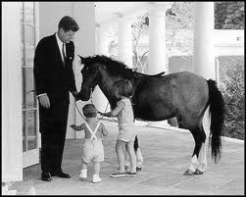
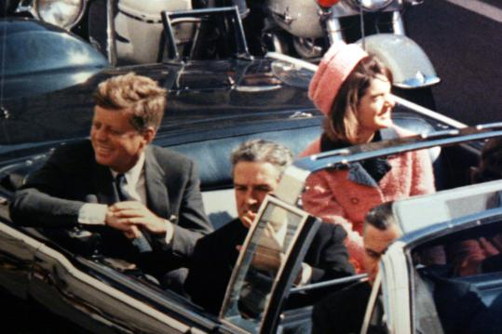
Personal Facts
JFK’s First Lady was Jacqueline Kennedy.
JFK had a daughter named Caroline and two sons named “John-John” and Patrick. Patrick died when he was born.
He had three horses, a rabbit, a cat and ten dogs.
JFK was assassinated in Dallas Texas, by Lee Harvey Oswald on November 22, 1963.

Slide 4
In Office Facts
John Fitzgerald Kennedy was the 35th President.
He was the President from 1961 to 1963.
John F Kennedy was elected when he was 44 years old.
John F Kennedy’s Vice President was Lyndon B Johnson.

Slide 5
In Office Facts
His political party was Democrat.
Kennedy got 34,226,731 votes.
He earned $100,000 and an expense account that he refused to take.

Slide 6
Fun Facts
Kennedy was in World War II before he was president.
Kennedy was the youngest President elected.
He was the only president to be Roman Catholic.

Slide 7
by GF Longino
By Oliver Dyson

Slide 8
Resources
POTUS
President Encyclopedia
Fact Monster
Miller Center
Presidential Pets by Julia Moberg
I Wish I Knew That President by P.A Halbert

Slide 9
THE END

