Slide 1
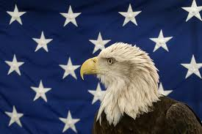
Franklin Roosevelt
By: Grace and Reese

Slide 2
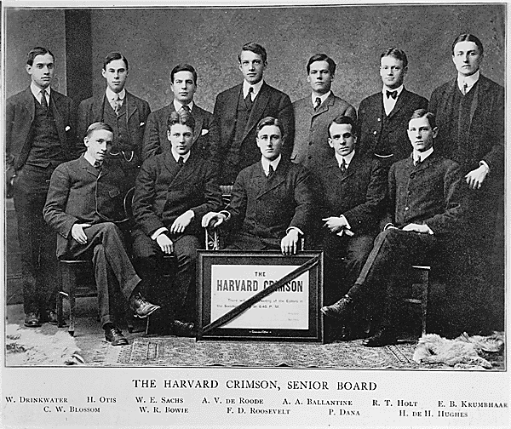
PERSONAL FACTS
He was born on January, 30 th 1882 in Hyde Park, New York.
His parents were Anna and James.
His children were John, Elliott, Franklin, Anna and John.
He lived in New York .

Slide 3
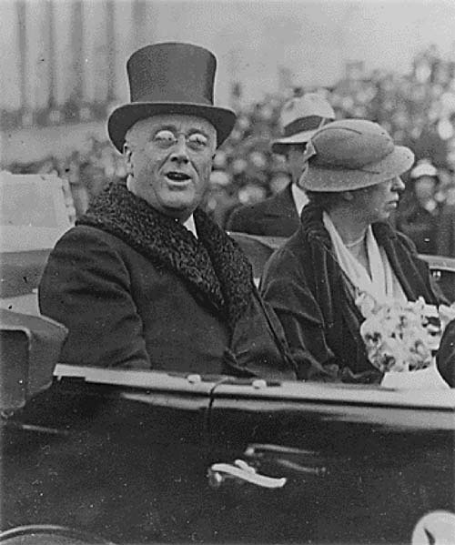
PERSONAL FACTS
He went to school at Harvard College (1903) and Attended Columbia Law school.
He died April 12, 1945 in Warm Springs, Georgia.
He got a terrible headache and hours later he was dead.

Slide 4
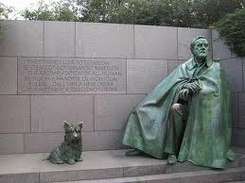
IN OFFICE FACTS
Franklin Roosevelt was the 32nd President.
He was in office from March 4th, 1933 to April 12th, 1945.
He was 51 when he was elected.
His Vice Presidents were John N. Garner, Henry A. Wallace and Harry S. Truman.
Roosevelt was a Democrat.

Slide 5
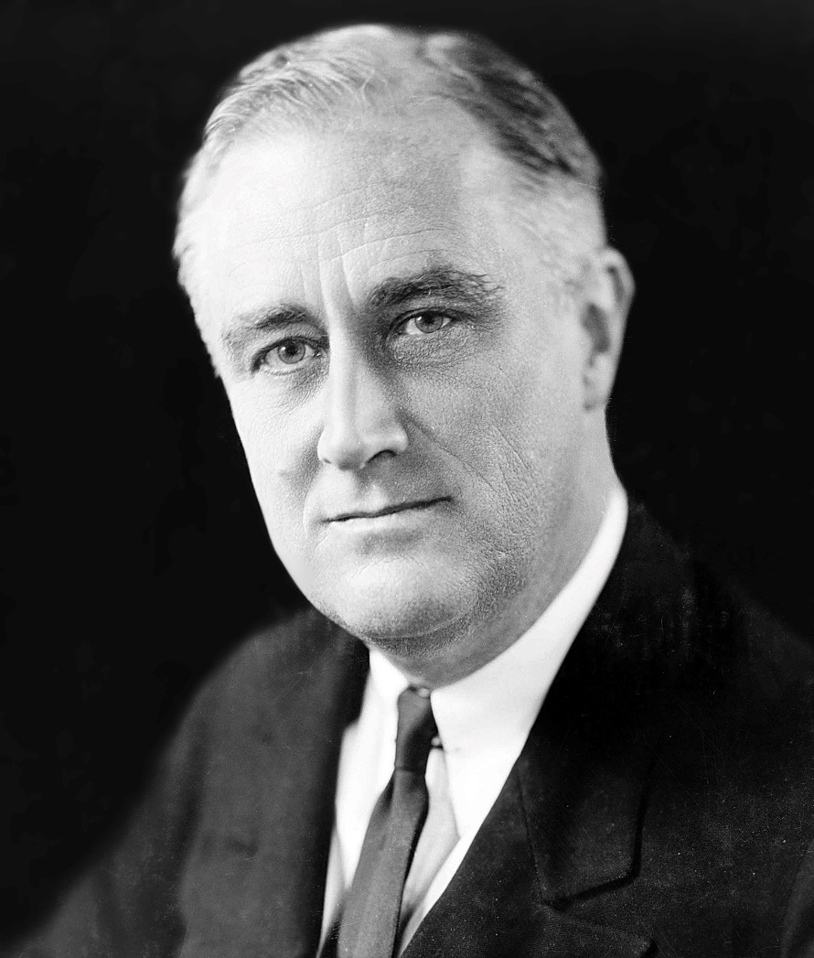
IN OFFICE FACTS
Roosevelt got 22,809,638 votes.
He got paid $75,000 dollars a year.
There was a huge war in 1941 when he was president. It was World War II.

Slide 6
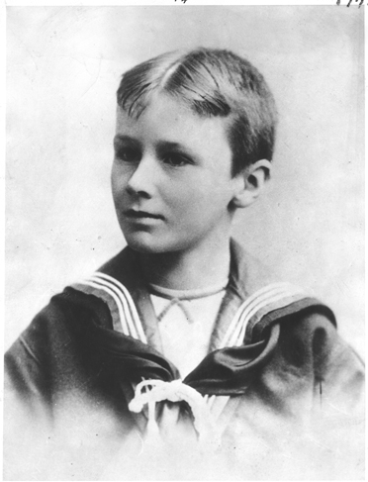
FUN FACTS
His mother and father were James and Sara.
He had a terrier and a German Shepherd, a setter, a sheepdog, a Great Dane, and a mastiff.
On February 15, 1933 Giuseppe Zangara attempted to kill Roosevelt.

Slide 7
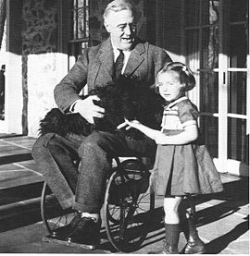
FUN FACTS
His nickname was FDR.
At the age 39 he got a disease called polio.

Slide 8
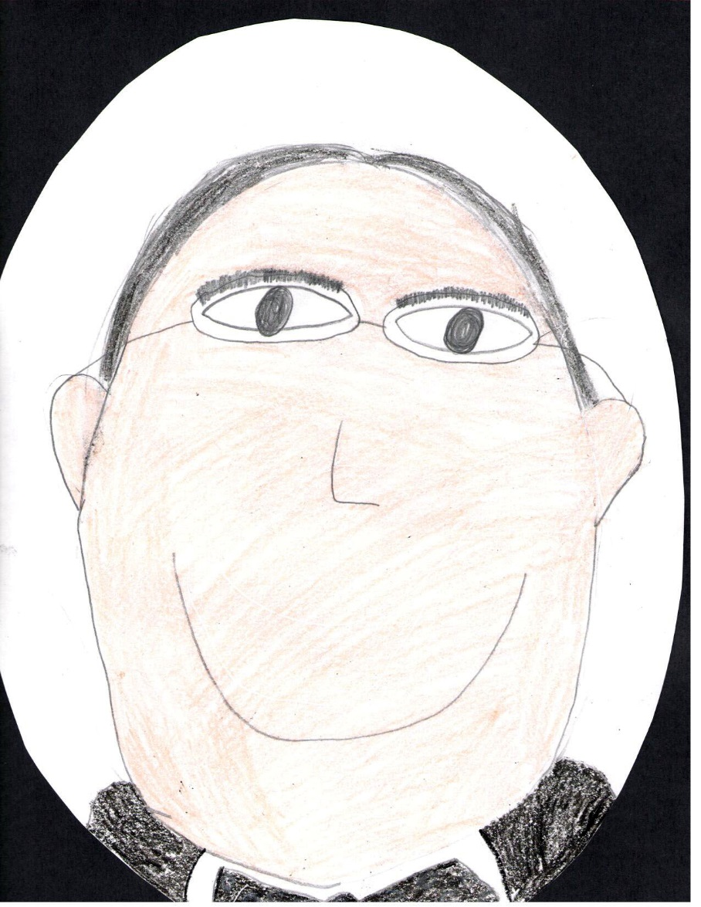
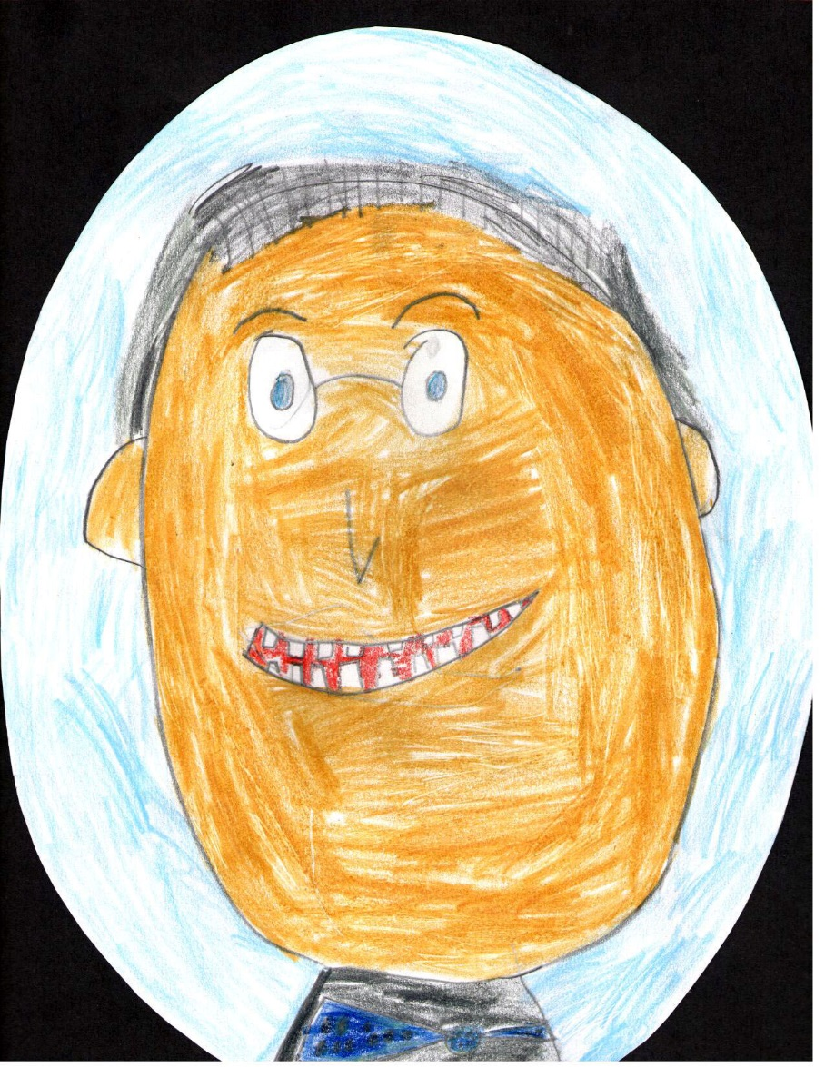
By: Grace
By: Reese

Slide 9
Resources
POTUS
President Encyclopedia
Fact Monster
Miller Center
Presidential Pets by Julia Moberg
I Wish I Knew That President by P.A Halbert

Slide 10
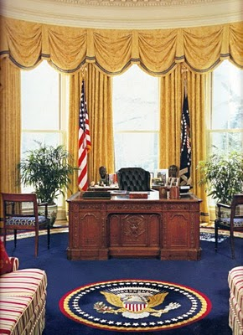
THE END

