Slide 1
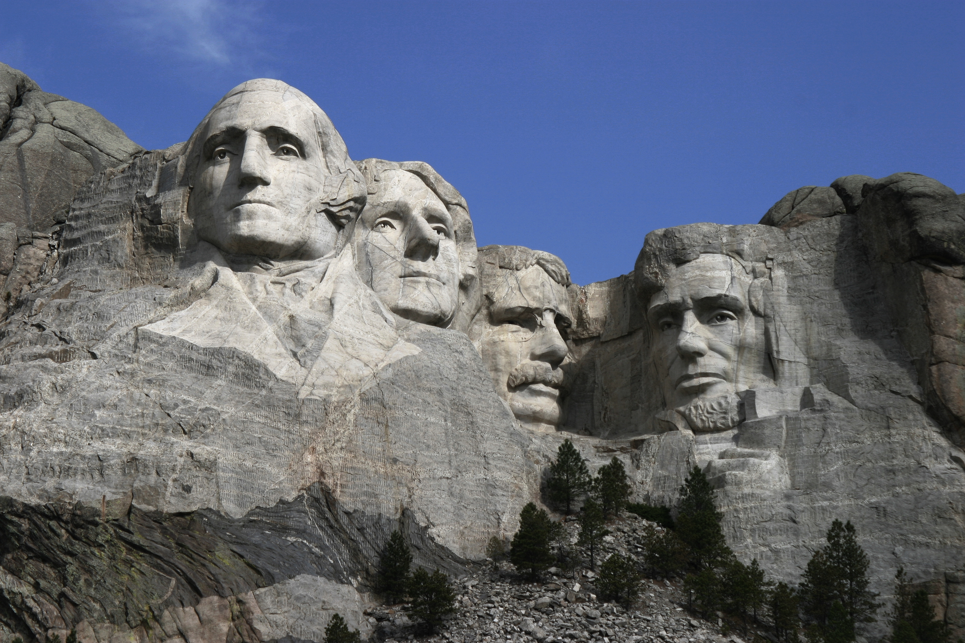
Thomas Jefferson
By Evie and Sean

Slide 2
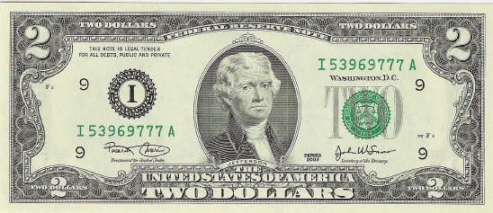
Personal Facts
Thomas Jefferson was born on April 13, 1743 in Shadwell, Virginia.
His father was Peter Jefferson and his mother was Jane Jefferson.
He had six sisters and one brother.
He lived in Shadwell, Virginia.
His school was William and Mary.
His first lady was Martha.

Slide 3
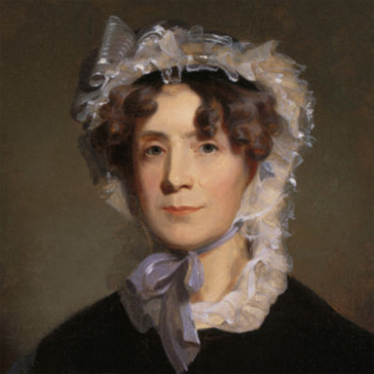
Personal Facts
Thomas Jefferson’s had five children named Martha , Jane, Mary, Lucy and Lucy.
He was a member of the Virginia House of Burgesses from 1769 to 1774.
Thomas Jefferson died on July 4^{th,} 1828.

Slide 4
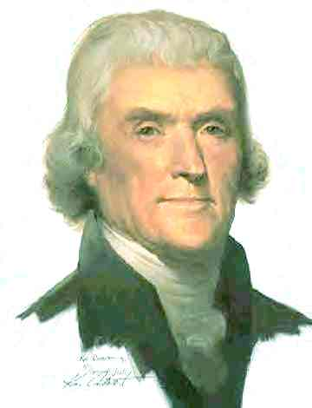
In Office Facts!
Thomas Jefferson was the 3rd President of the United States.
He was President from March 4, 1808 to March 3, 1809.
Thomas Jefferson made $25,000 a year!

Slide 5
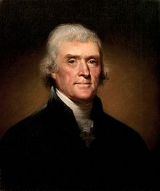
In Office Facts!
There was no war when Thomas Jefferson was president.
Thomas Jefferson’s Vice Presidents were Aaron Burr and George Clinton.
Thomas Jefferson’s political party was at the Democratic- Republican.

Slide 6
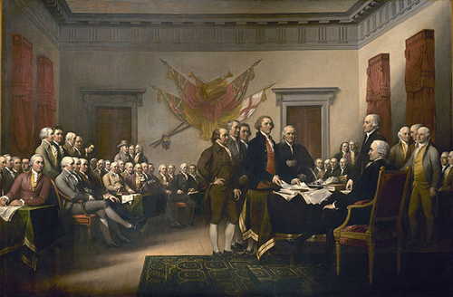
President Fun Facts!
Thomas Jefferson’s nickname was “Man of the People” and “Sage of Monticello”.
He signed Declaration of Independence.

Slide 7
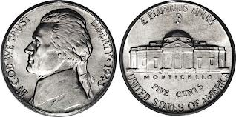
Fun Facts!
His nickname was “Man Of People”.
Jefferson was the first president to be inaugurated in Washington, D.C.
His picture is on the nickel.

Slide 8
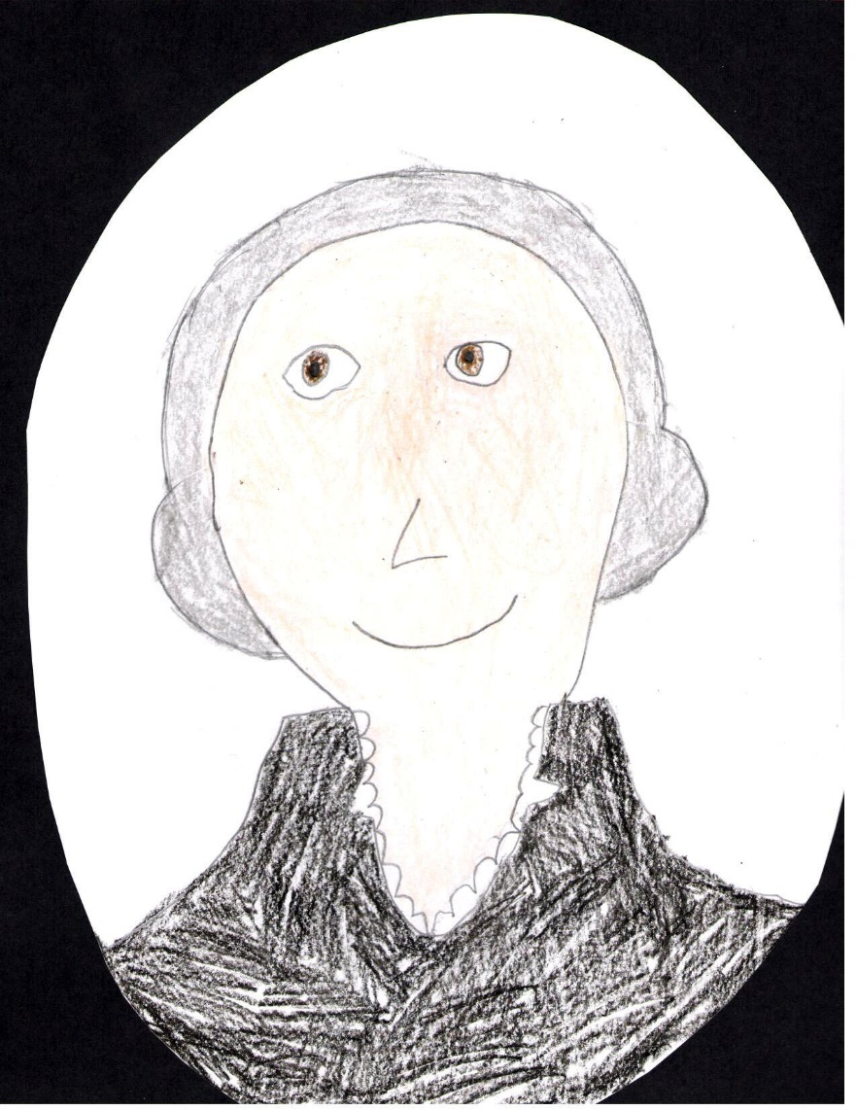
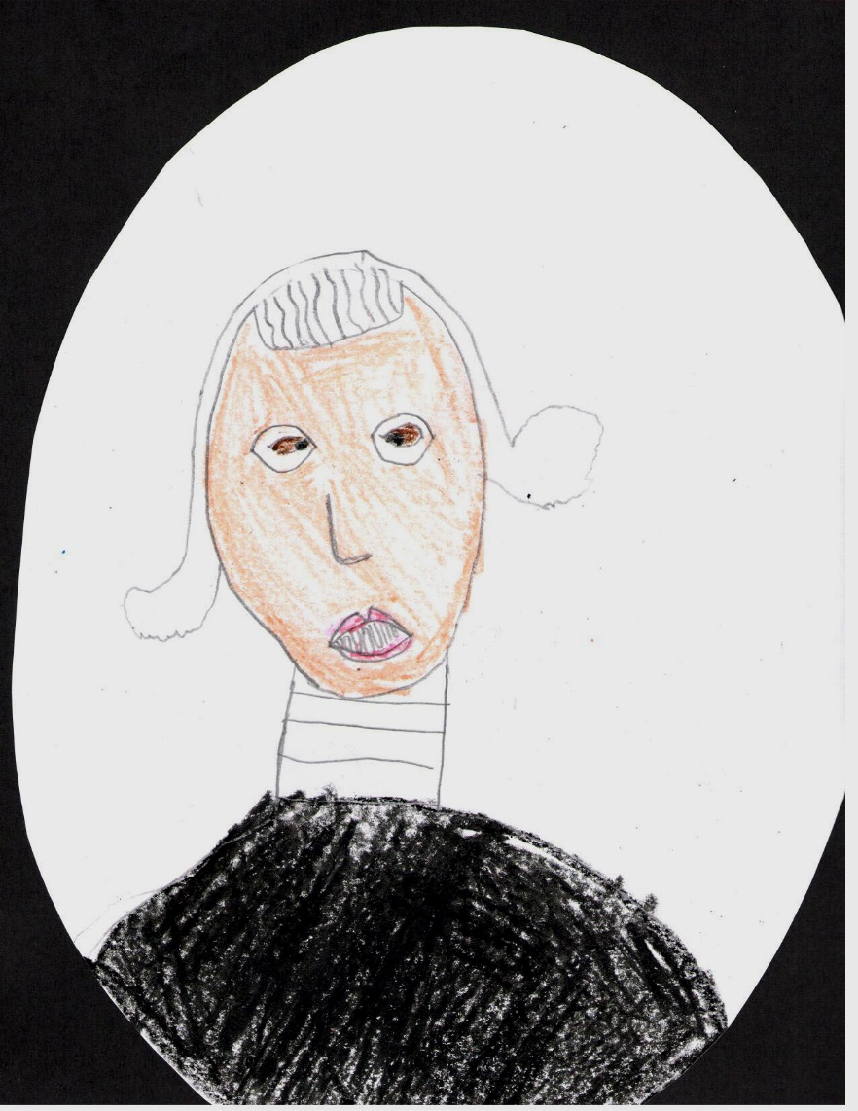
By Evie
By Sean

Slide 9
Resources
POTUS
President Encyclopedia
Fact Monster
Miller Center
Presidential Pets by Julia Moberg
I Wish I Knew That President by P.A Halbert

Slide 10
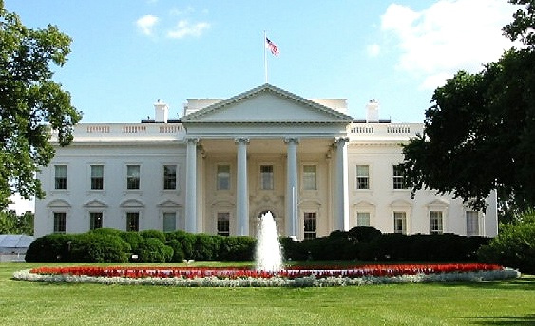
THE END

