Slide 1
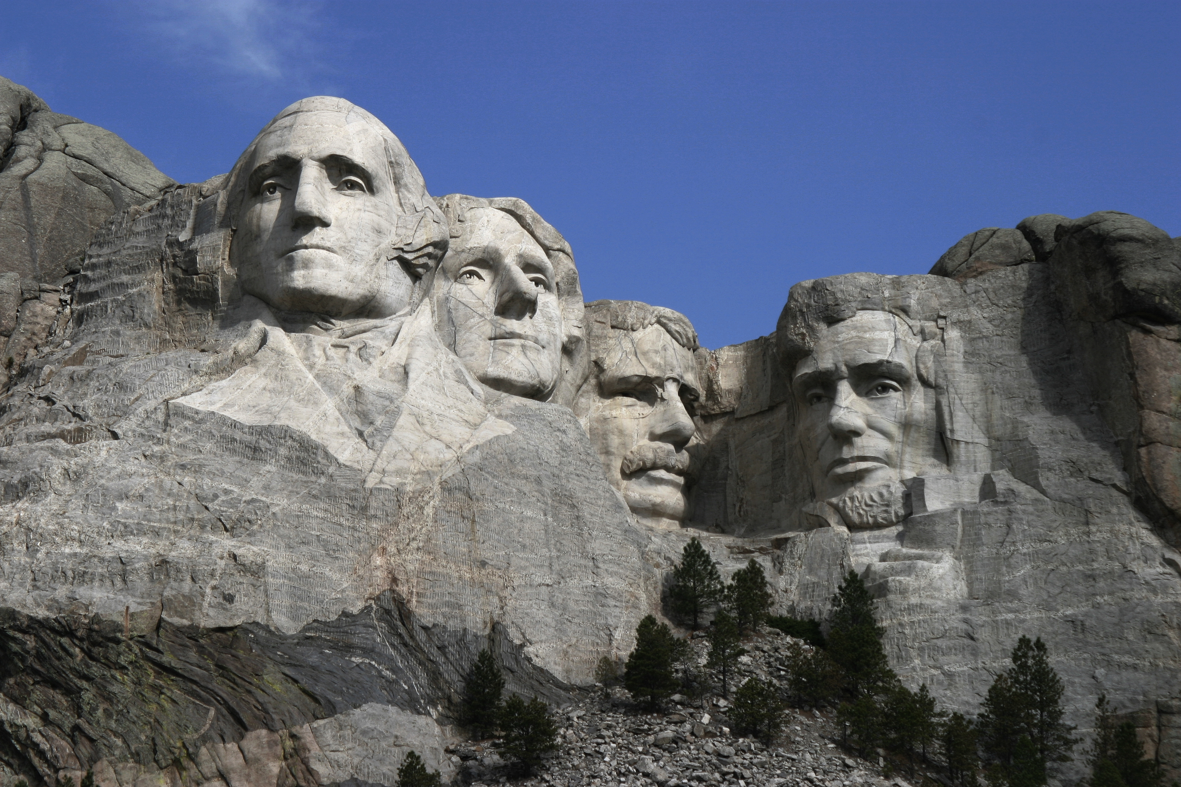
Franklin Delano Roosevelt
By Neal and Eliot

Slide 2
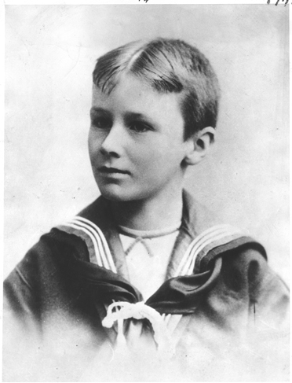
Personal Facts
Roosevelt was born on January 30th, 1882 in Hyde Park, New York.
His dad’s name was James Roosevelt and his mom’s name was Sara Roosevelt.
Franklin did not have any siblings.
He grew up in New York.
He went to Harvard College.

Slide 3
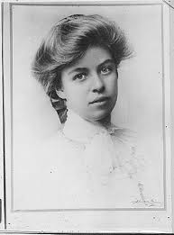
Personal Facts
Roosevelt’s wife was Anna Eleanor Roosevelt.
His 5 kids name’s were Anna, James, Elliott, Franklin and John.
His pets were a Scottish terrier, a setter, a German shepherd, a sheepdog, a Great Dane and a mastiff.
He was in the Navy before he was president.

Slide 4
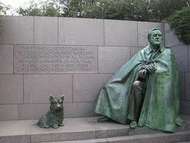
Personal Facts
He died in Warm Springs, Georgia on April 12th, 1945. He died from brain hemorrhage.

Slide 5
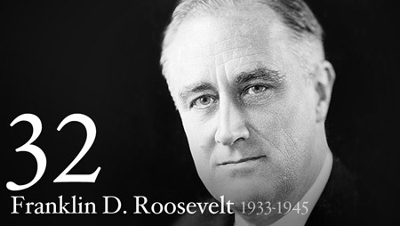
In Office Facts
Franklin D. Roosevelt was the 32nd president.
He was in office from March 4, 1933 to April 12, 1945.
His Vice President was John N. Garner.
He was 51 when he became President.

Slide 6
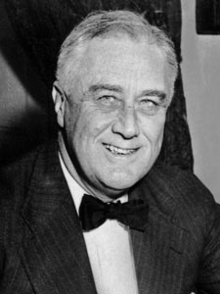
In Office Facts
He was a Democrat.
On September 1, 1939, Roosevelt entered the war with Germany, Italy and Japan. It was World War II.
He got $75,000 each year as president.

Slide 7
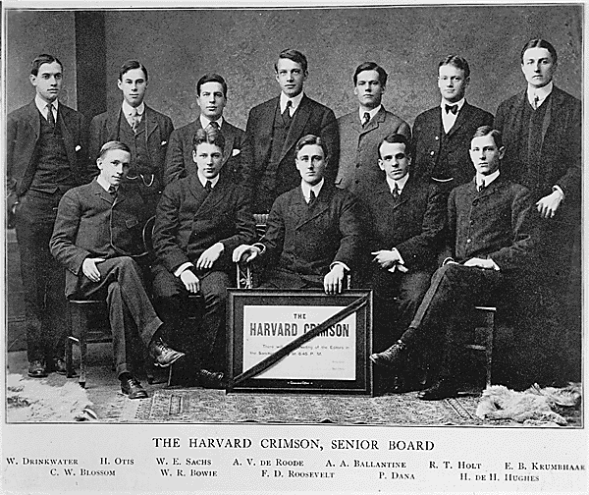
Fun Fact
He went to Harvard College.

Slide 8
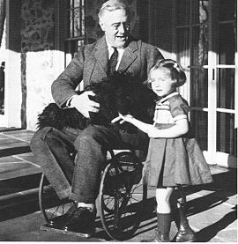
Fun facts
His legs were paralyzed by polio at age 39.
We went to war with Japan and Germany because Japan bombed Hawaii.

Slide 9
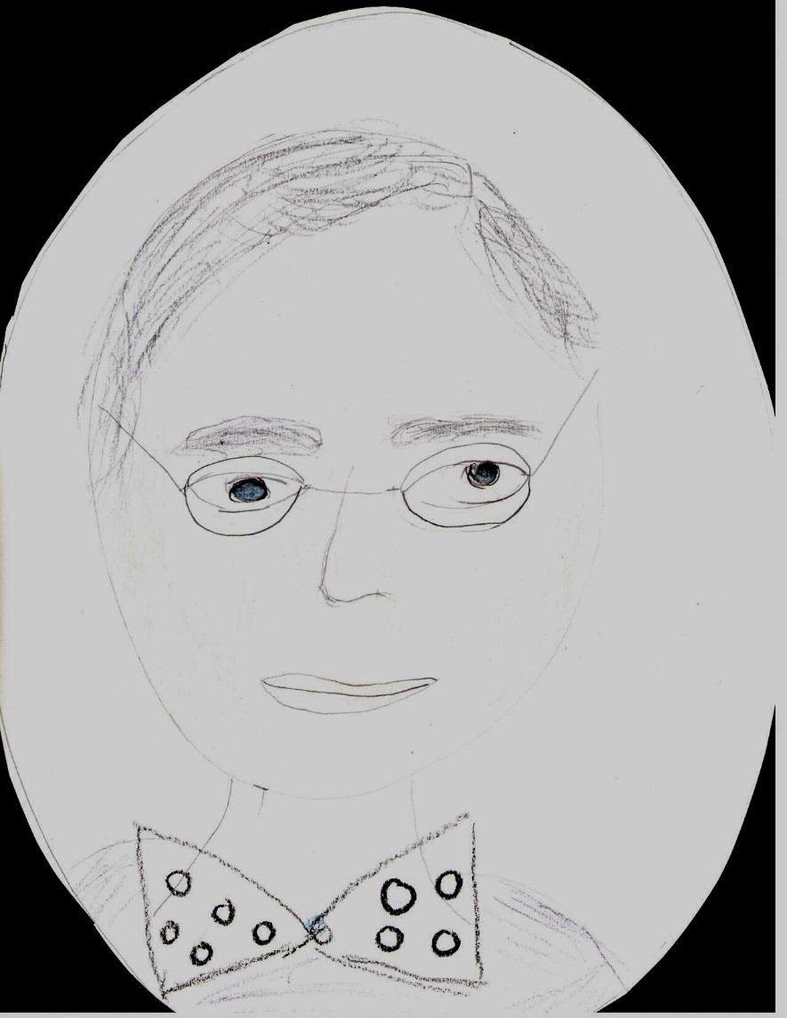
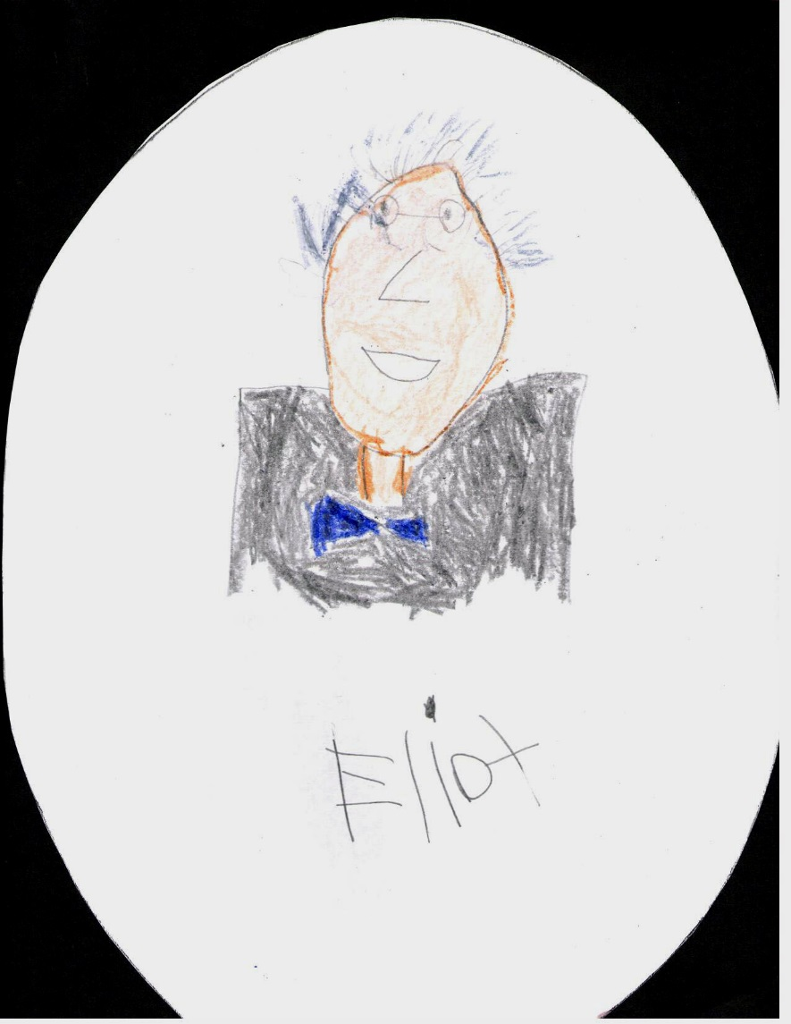
By Neal
By Eliot

Slide 10
Resources
POTUS
President Encyclopedia
Fact Monster
Miller Center
Presidential Pets by Julia Moberg
I Wish I Knew That President by P.A Halbert

Slide 11

THE END

