Slide 1
Harry S. Truman
By Dugan

Slide 2
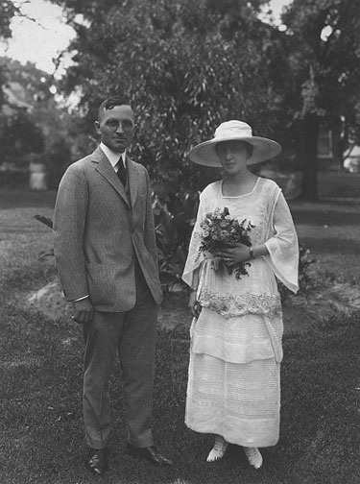
Personal Facts
Harry Truman was born May 8th, 1884 in Lamar, Missouri.
His father’s name was John Anderson Truman and his mother’s name was Martha Ellen Young Truman.
He went to the University of Kansas City Law School.
Harry Truman’s wife was Elizabeth ‘’Bess’’ Virginia Wallace.

Slide 3
Personal Facts
Harry Truman had one child named Mary Margaret Truman.
Harry Truman had one dog named Feller ‘’The unwanted dog’’.
He died December 26th, 1972 in Kansas city Missouri.

Slide 4
In Office Facts
Harry S. Truman was the 33rd President.
He was President from 1945 to 1953.
He was 61 when he was elected President.
There was a war when he was President. The war was World War II.

Slide 5
In Office Facts
He got 24,179,345 popular votes and 303 electoral votes.
He was a Democrat.

Slide 6
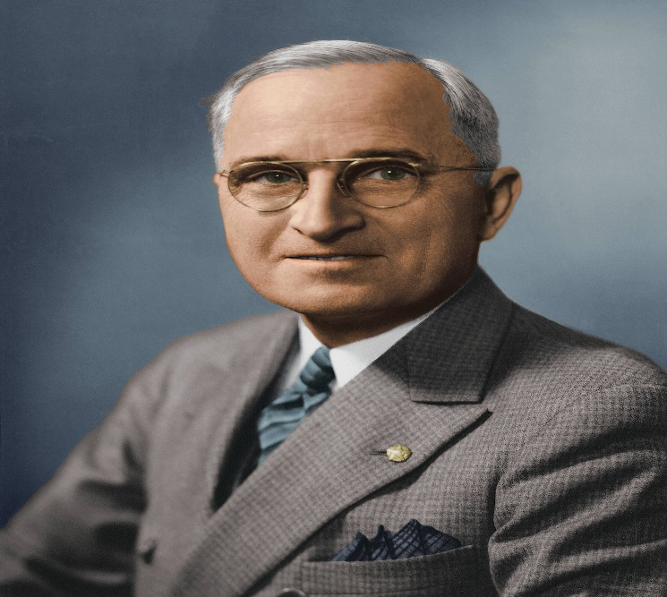
Fun Facts
He dropped atomic bombs on Japan.
Truman signed the National Security Act of 1947.
In 1949, Truman established alliances with Canada and much of western and northern Europe.
His Presidential address was the first one to be on radio.

Slide 7
By Dugan

Slide 8
Resources
POTUS
President Encyclopedia
Fact Monster
Miller Center
Presidential Pets by Julia Moberg
I Wish I Knew That President by P.A Halbert

Slide 9
The End

