Slide 1
John F. Kennedy
By Davis Dutton and Audrey Barnett

Slide 2
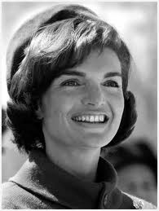
Personal Facts
John Kennedy was born on May 29th, 1917 in Brookline Massachusetts.
He had a cat named Tom and dog named Pushinka.
Kennedy Graduated from Harvard College in 1940.
His First lady was Jacqueline Lee Bouvier.

Slide 3
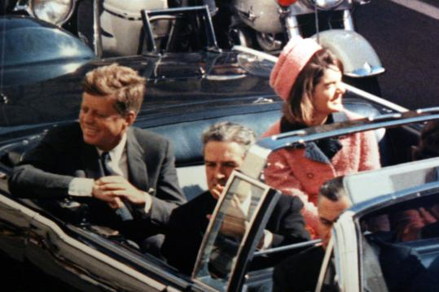
Personal Facts
He had two children named Caroline and John.
His occupation was author and public official.
John Kennedy was assassinated in Dallas, Texas on November 22nd, 1963.

Slide 4
In Office Facts
John F. Kennedy was the 35th President.
He was in office from January 20th 1961 to November 22nd 1963.
Kennedy was 44 when he was elected.
His Vice President was Lyndon B. Johnson.

Slide 5
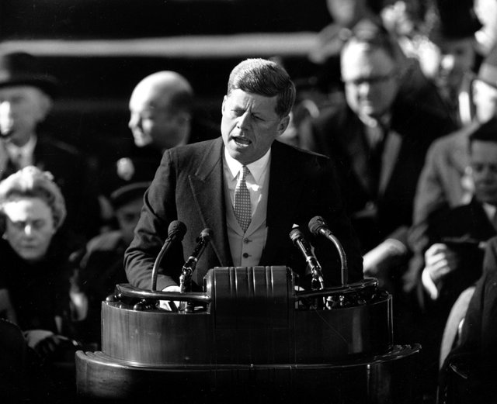
In office facts
His Political Party was the Democrat.
The votes of the people were 34,226,731.
Kennedy made $100,000 a year.
There was not a war when he was president.

Slide 6
Fun Facts
Kennedy is one of two presidents buried at Arlington National Cemetery.

Slide 7
Fun facts
In October he had surgery on his back.
John F. Kennedy was born into a rich family.

Slide 8
By Davis
By Audrey

Slide 9
Resources
POTUS
President Encyclopedia
Fact Monster
Miller Center
Presidential Pets by Julia Moberg
I Wish I Knew That President by P.A Halbert

Slide 10
THE END

