Slide 1
GEORGE WASHINGTON
By Connor and Elizabeth

Slide 2
PRESIDENT’S PERSONAL FACTS
George Washington was born February 22nd 1732 in Westmoreland County, Virginia.
His mother was Mary Ball Washington and his father was Augustine Washington
He had a step brother.
George Washington lived in Virginia.
He didn’t go to a school.

Slide 3
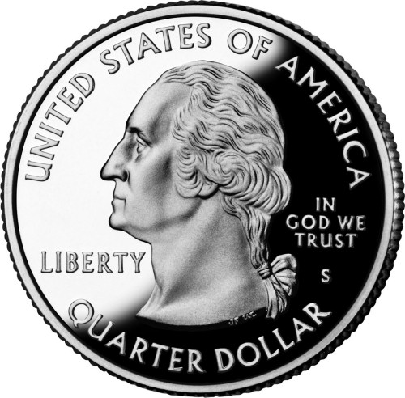
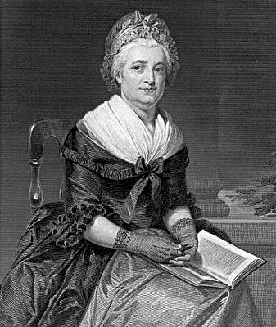
President’s Personal Facts
George Washington married Martha Dandridge Custis.
He adopted John and Martha.
George Washington had 36 hounds and a parrot and horses.
He was a general during the American Revolution.

Slide 4
IN OFFICE FACTS
George Washington was the first president.
He was in office from April 30th , 1789 to March 3rd , 1797.
He was 57 when he was elected.
His Vice President was John Adams.
He was not in a formal political party.

Slide 5
IN OFFICE FACTS
George Washington made $25,000 a year.
There was no war when George Washington was President.

Slide 6
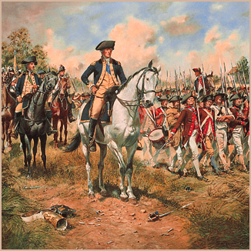
FUN FACTS
George Washington’s face is on Mount Rushmore.
He was in the French and Indian war.
There is a bridge named after him.
He had a step brother named Lawrence Washington.

Slide 7
FUN FACTS
He never had wooden teeth.
He bowed to his visitors.
All of his horses were white and obeyed him.
He was the commander of the Revolutionary war.

Slide 8
Fun Facts
George Washington’s teeth were constructed of elephant and walrus tusks.

Slide 9
By Elizabeth
By Connor

Slide 10
Resources
POTUS
President Encyclopedia
Fact Monster
Miller Center
Presidential Pets by Julia Moberg
I Wish I Knew That President by P.A Halbert

Slide 11
THE END

