Slide 1
John Adams
By Carter Moran and Roma Boren

Slide 2
Personal Facts
John Adams was born on October 30th, 1735 in Braintree, Massachusetts.
His Parents were John Adams and Susanna Boylston Adams.
He had two younger brothers.
He lived on a farm in Massachusetts.
Adams went to Harvard College.

Slide 3
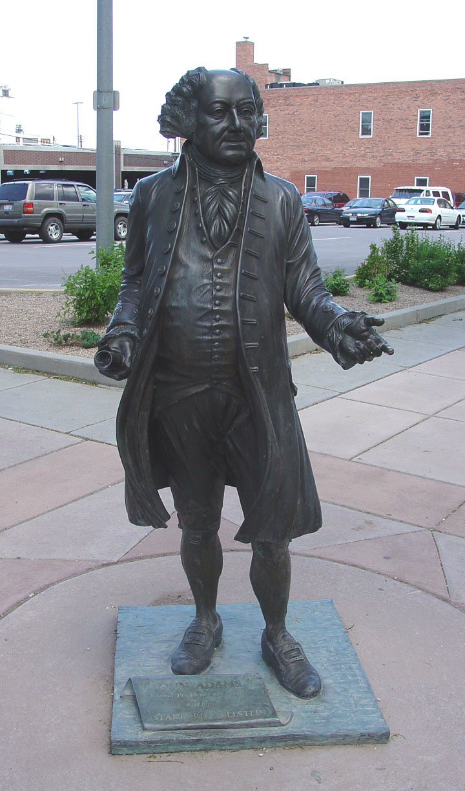
Personal Facts
His wife was Abigail Smith.
Adams had one daughter named Abigail Amelia Adams.
He had many horses.
He was a lawyer.
John Adams died July 4th, 1826 in Baintree, Massachusetts. He got very sick and died.

Slide 4
In Office Facts
John Adams was the 2nd President.
He was President from March 4th, 1797 to March 3rd, 1801.
He was 61 when he was elected.

Slide 5
In Office facts
He was in the Federalist party.
His Vice President was Thomas Jefferson.

Slide 6
Fun Facts
His nickname was Atlas of Independence.
John Adams died on the 4th of July.
John Adams was born the day before Halloween.
John Adams and Thomas Jefferson died on the same day.

Slide 7
Fun Fact
John Adams signed the Declaration of Independence.

Slide 8
By Carter
By Roma

Slide 9
Resources
POTUS
President Encyclopedia
Fact Monster
Miller Center
Presidential Pets by Julia Moberg
I Wish I Knew That President by P.A Halbert

Slide 10
The End

