Slide 1
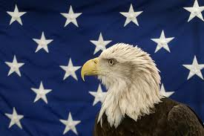
John Adams
By Amelia and Dylan

Slide 2
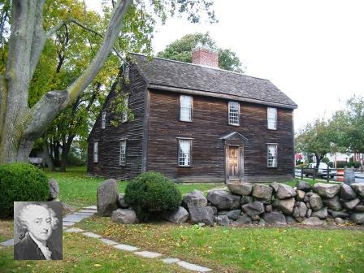
PERSONAL FACTS
John Adams was born on October 30th 1735 in Braintree, Massachusetts.
His parents were John Adams and Susanna Boylston Adams.
He had two brothers.
He graduated from Harvard College.

Slide 3
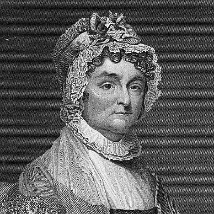
Personal Facts
His wife was Abigail Smith.
He lived in Massachusetts.
His children were Abigail Amelia, John Quincy, Charles, Thomas Boylston and Susanna Adams.
He died on July 4, 1826 in Braintree, Massachusetts.

Slide 4
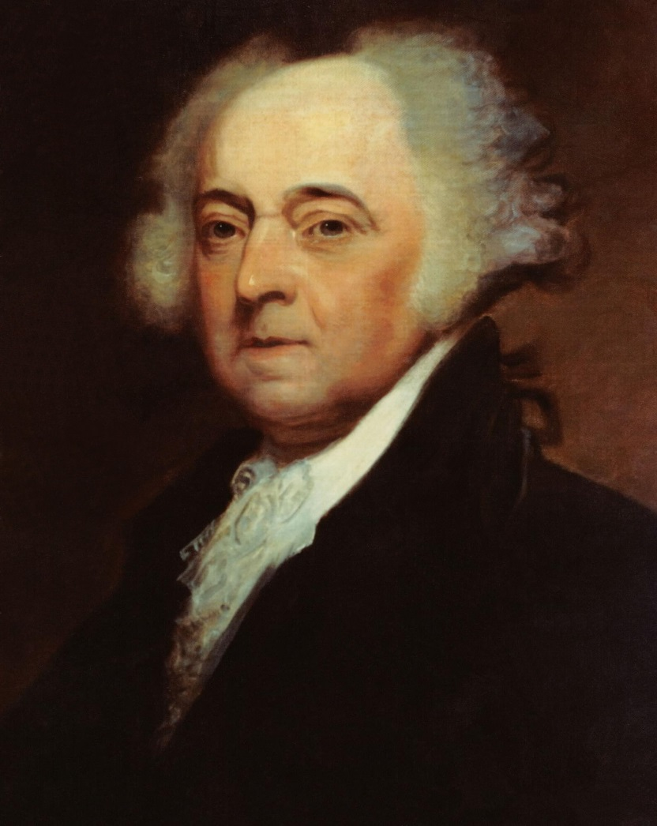
IN OFFICE FACTS
John Adams was the 2nd President.
He was in office from March 4, 1798 to March 3, 1801.
He was 62 when he was elected.
His Vice President was Thomas Jefferson.

Slide 5
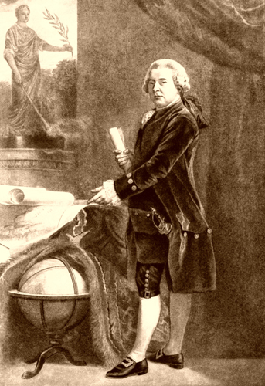
IN OFFICE FACTS
His political party was the Federalist.
He made $25,000 dollars a year.
America almost had a war with France in 1797.

Slide 6
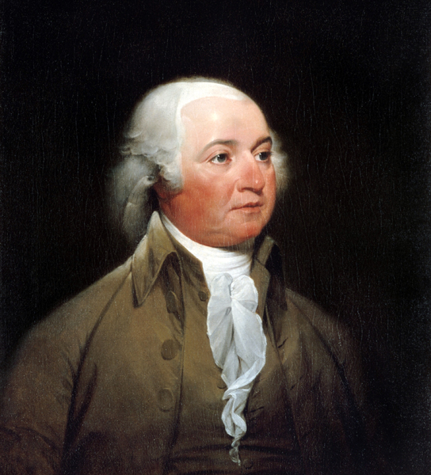
FUN Facts
His nickname was “Atlas of Independence”.
Susanna Adams died when she was just a baby.
John Adams and Thomas Jefferson signed the Declaration of Independence.

Slide 7
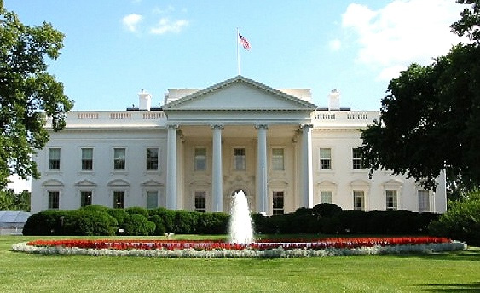
FUN FACTS
His was Vice President for George Washington.
He was the first president to live in the White House.
John Adams died on the same day as Thomas Jefferson. They were best friends.
His son became President.

Slide 8
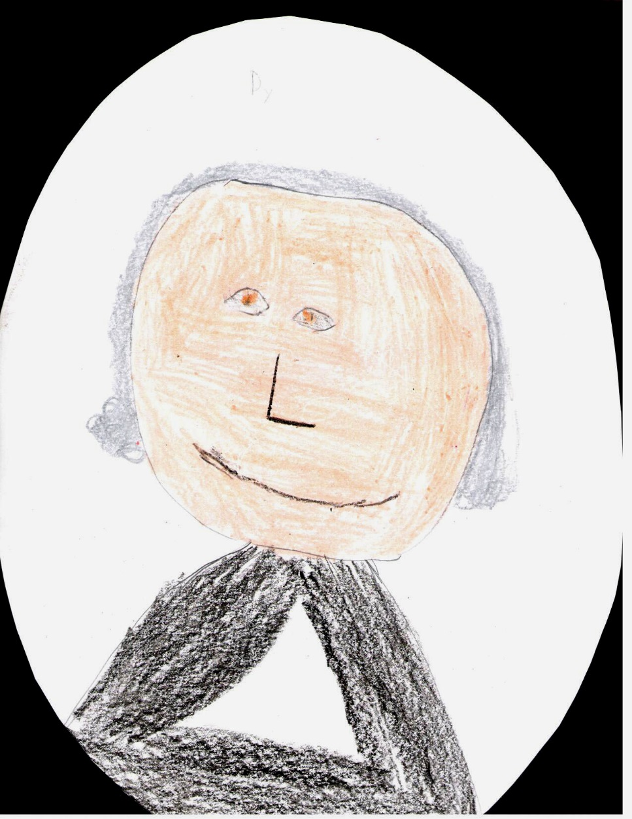
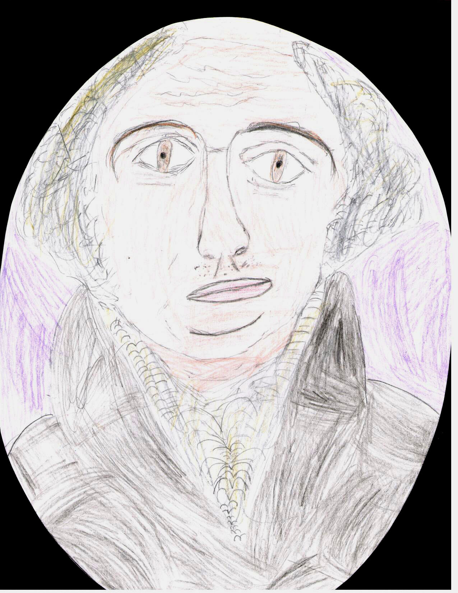
By Dylan
By Amelia

Slide 9
Resources
POTUS
President Encyclopedia
Fact Monster
Miller Center
Presidential Pets by Julia Moberg
I Wish I Knew That President by P.A Halbert

Slide 10

THE END

