Slide 1
Ronald Wilson Reagan
by Alexia and Lola

Slide 2
Personal Facts
Reagan was born February 6th, 1911 in Tampico, Illinois.
Ronald Reagan’s father was John Edward Reagan and his mom was Nelle Wilson Reagan.
Ronald Reagan went to school at Eureka College.

Slide 3
Personal facts
Ronald Reagan’s first wife was Jane Wyman. His second wife and First Lady was Nancy Davis.
His children's names were Maureen, Mitchel, Patricia and Ron Reagan.
His pet’s were Rex, a King Charles Spaniel and Lucky, a sheepdog.
Ronald Reagan lived in California.

Slide 4
Personal Facts
Ronald Reagan made over 50 movies.
Ronald Reagan died June 5th, 2004 in Los Angeles California.
He was the oldest president to enter the White House and he was 69.

Slide 5
In Office Facts
Ronald Reagan was in office January 1981 to January 1989
His salary was $200,000 a year and a $50,000 expense account.
Ronald Reagan's Vice President was George Bush.
His political party was Republican.

Slide 6
In Office Facts
He got 53,428,357 votes the second time he ran for President.
He sent troops to Grenada.

Slide 7
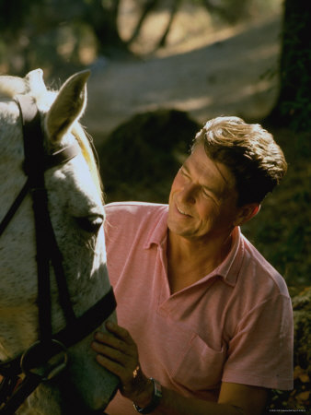
Fun Facts
Ronald Reagan was hard of hearing because in the 1930’s another actor shot a pistol near his ear.
Before being president he was an actor, a life guard and the Governor of California.

Slide 8
Fun Facts
Ronald Reagan’s nicknames were the Gripper and the Great Communicator.
Ronald Reagan survived after he got shot.
Ronald Reagan was the Governor of California.

Slide 9
By Alexia By Lola

Slide 10
Resources
POTUS
President Encyclopedia
Fact Monster
Miller Center
Presidential Pets by Julia Moberg
I Wish I Knew That President by P.A Halbert

Slide 11
THE END

