Slide 1
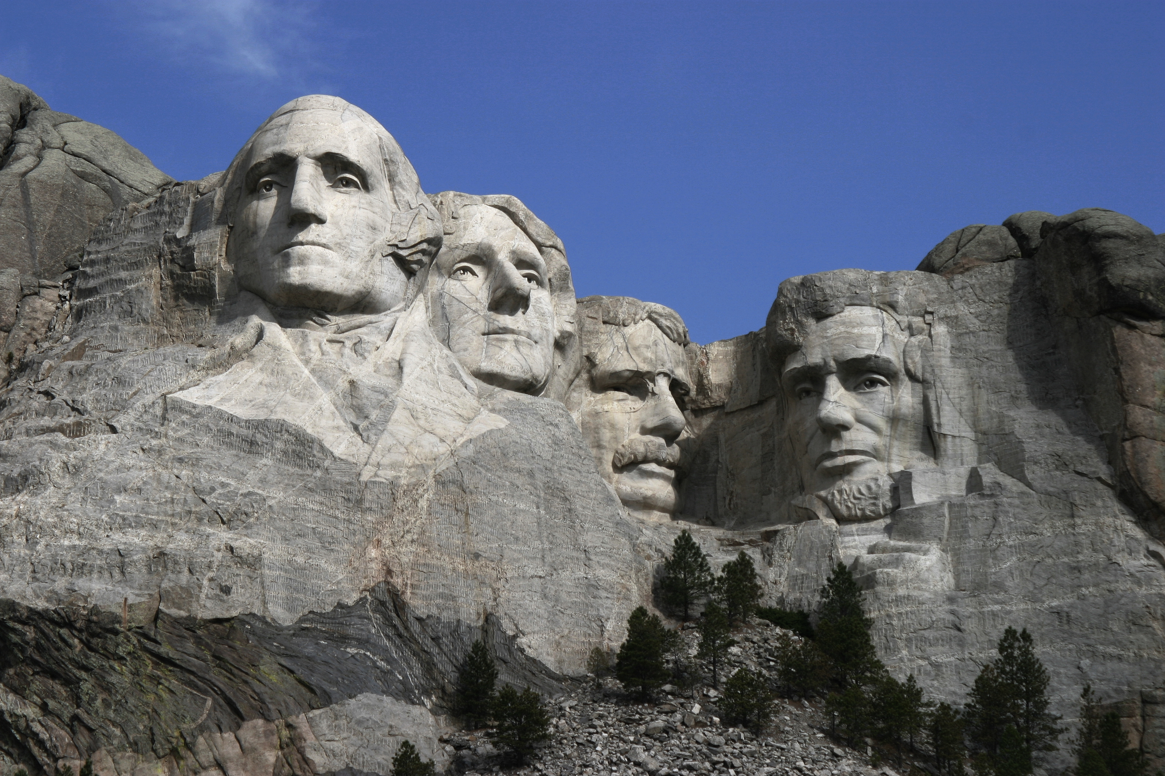
George Washington
By Alex Balestrieri and Lucy Saylors

Slide 2
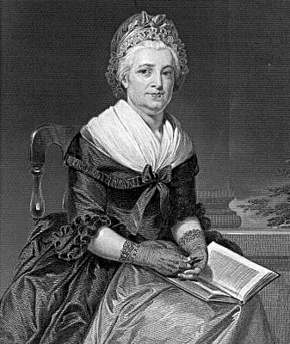
Personal Facts
George Washington was born February 22, 1732 in West Moreland County, Virginia.
His parents names were Augustine Washington and Mary Ball Washington.
George Washington had a step brother.
He had no formal education.

Slide 3
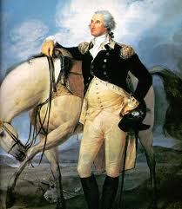
Personal Facts
His First Lady was Martha Dandridge Custis
He had two children and their names were John and Martha.
He had one parrot, 36 hounds and many horses.
He was a planter and a soldier.

Slide 4
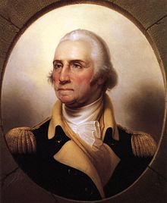
In Office Facts
George Washington was the 1st President.
He was in office from April 30th, 1789 to March 3rd, 1797.
His Vice President was John Adams.
He had no formal political party.

Slide 5
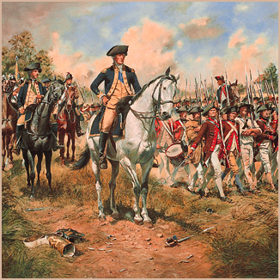
In Office Facts
His salary as president was $25,000 a year but he didn’t take the money.
There was not a war when he was president.

Slide 6
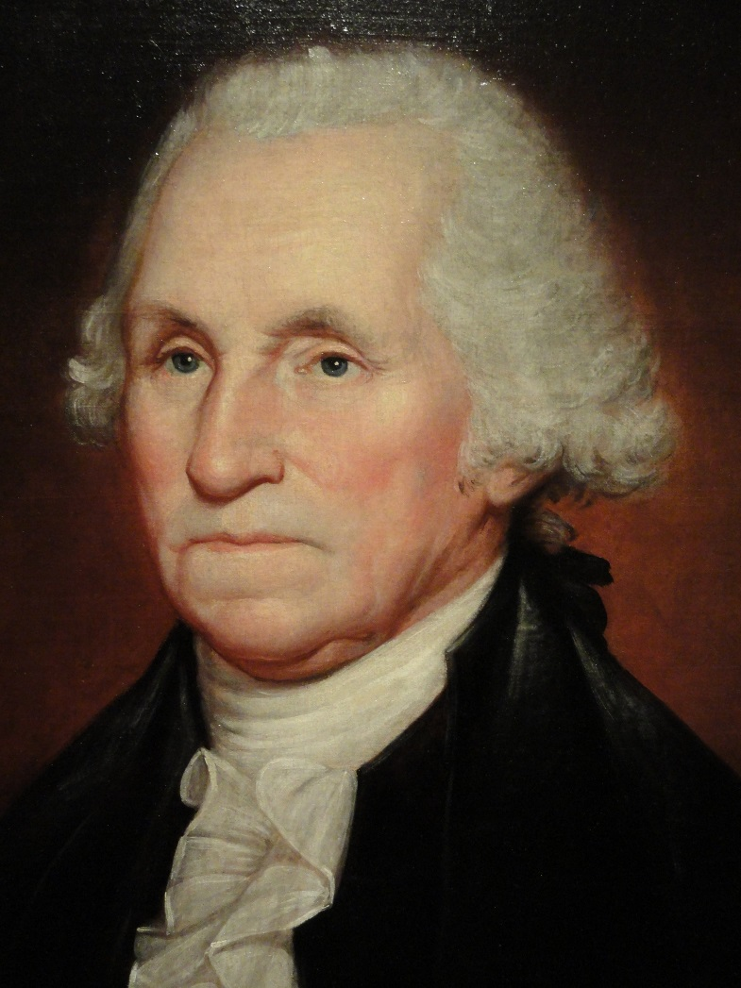
Fun Facts
He was six foot two and weighed 200 pounds.
He had reddish blond hair and his face was scarred from the smallpox.
He had problems with his teeth and he only had one tooth left when he died.

Slide 7
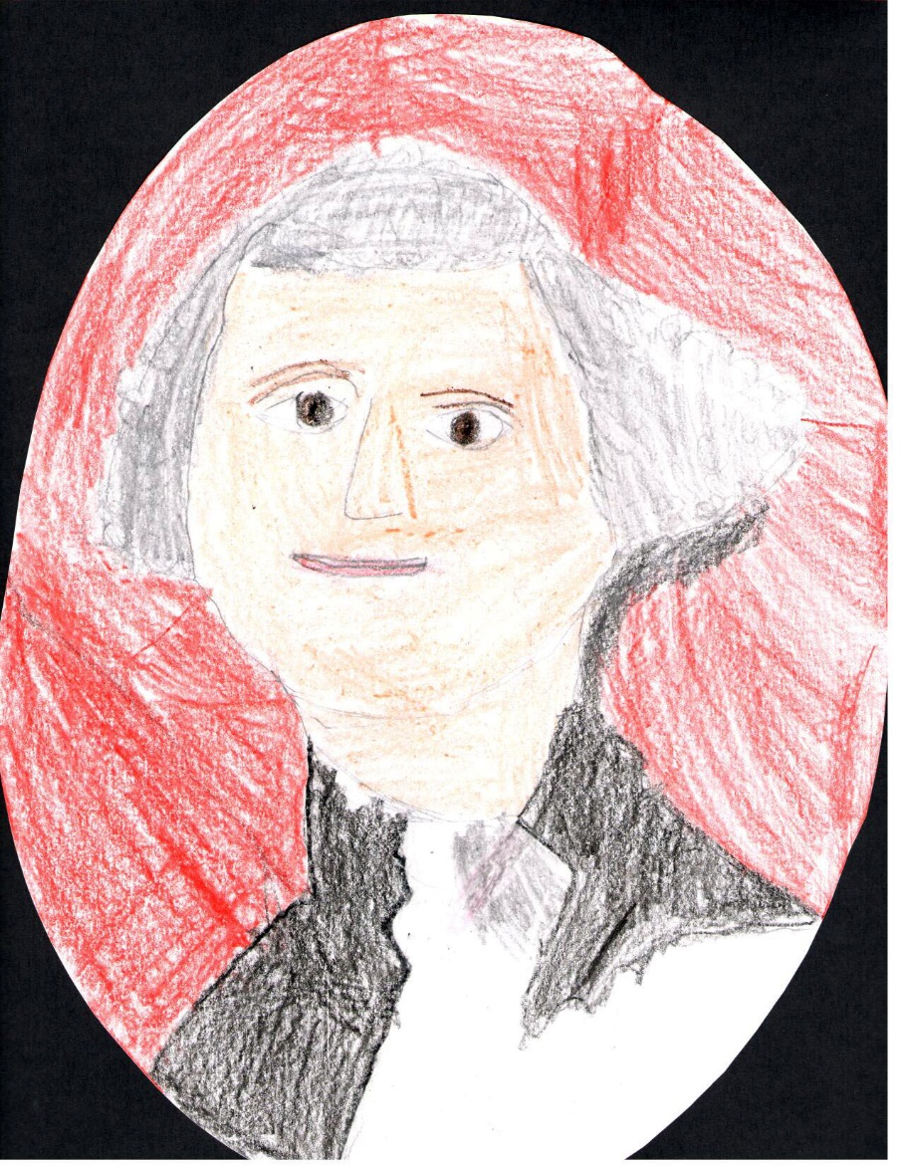
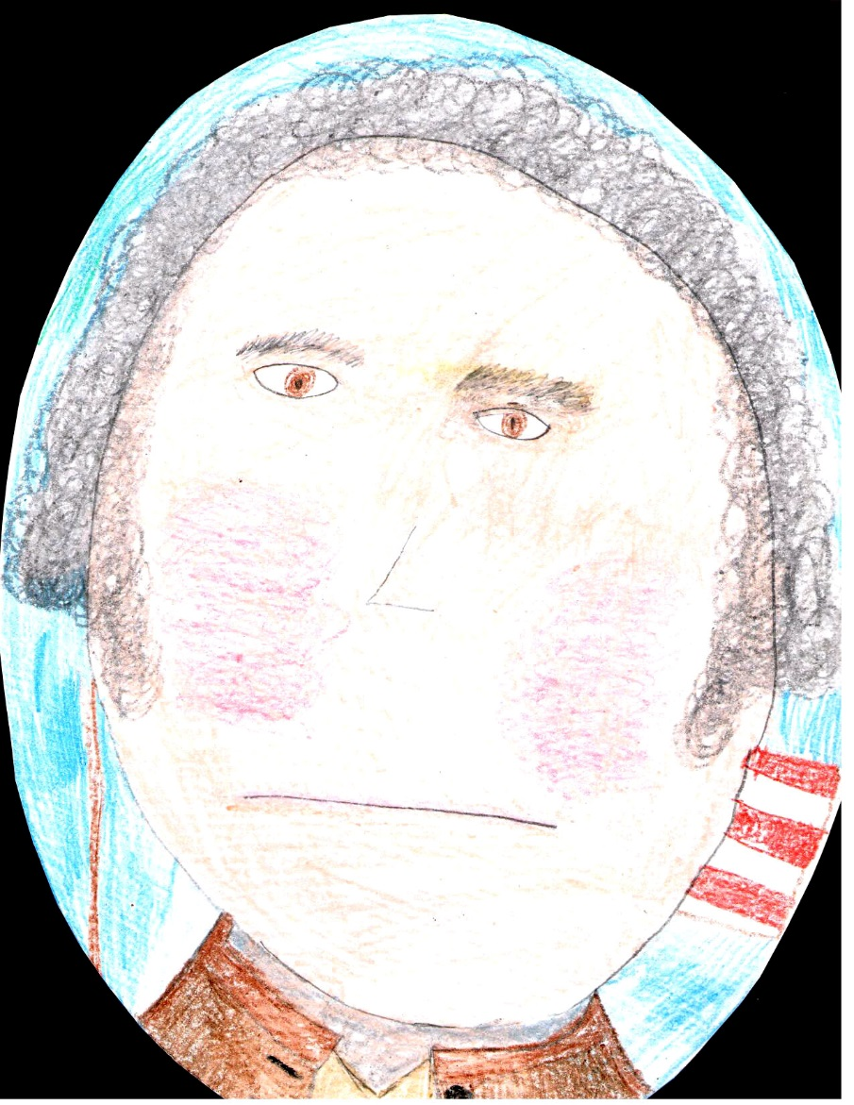
By Alex
By Lucy

Slide 8
Resources
POTUS
President Encyclopedia
Fact Monster
Miller Center
Presidential Pets by Julia Moberg
I Wish I Knew That President by P.A Halbert

Slide 9
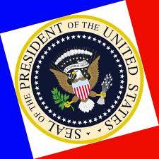
THE END

